Slide 1
Sexually Transmitted Infections + Pregnancy
LABBN Parent Coaches
Monday, August 14, 2023 9:00am – 10:30am
Katie Farro, MPH
She/her Pronouns
STI Prevention Specialist
Notes:
Good morning/afternoon. Today we will be discussing how to incorporate pregnancy intention and contraceptive information in your interactions with clients.
We’ll start off with an overview of reproductive health and justice, and then we will move into understanding the growing congenital syphilis epidemic. Finally, we will learn and practice tools to start conversations with clients and assist them when they face barriers to care. Congenital syphilis is an infection that can cause serious health conditions and sometimes even death in growing pregnancies and newborns. The infection is affecting a growing number of pregnant parents and newborns in Los Angeles and is preventable.
As community-based service providers, you are in a unique and important position to help prevent congenital syphilis. Before we get started, we want you to know that we do not expect you to become experts on reproductive health care or syphilis from this presentation. I do want to make sure you have tools to start conversations on prevention and connect clients with integrated referrals to quality care.

Slide 2
Objectives
Obtain an introduction to STI’s.
Understand how having STI’s can affect pregnancy.
Learn how STI’s can affect the baby.
Recognize the rising risk of congenital syphilis.
Gain knowledge on how STI’s can be tested and treated during pregnancy.
Notes:
Here are our objectives. After this presentation, you will be able to:
Obtain an introduction to STI’s.
Understand how STI’s can affect a pregnancy.
Learn how STI’s can affect the baby.
Recognize the rising risk of congenital syphilis.
Gain knowledge on how STI’s can be tested and treated during pregnancy.

Slide 3
Essential Access Health
Champions and promotes quality sexual + reproductive health care for all
Partners with the California Department of Public Health, STD Control Branch, LA County Department of Public Health, Division of HIV/STD Programs, and Title X Family Planning Programs
Implements best practices in STI prevention statewide
Notes:
We are from Essential Access Health. Our organization:
Champions and promotes quality sexual + reproductive health care for all
Partners with the CA STD Control Branch and LA County Division of HIV/STD Programs
Implements best practices in STI prevention statewide.
We achieve our mission through an umbrella of programs and services including clinic support initiatives, provider training, advanced clinical research, advocacy and consumer awareness. Essential Access Health supports the delivery of Title X-funded services to meet the family planning needs of uninsured residents and individuals with low-income in California and Hawaii.

Slide 4
Heads Up!
Your insight is valuable - please share your thoughts!
  Unmute, use “raise hand” or chat options
We will use MentiMeter, a polling website that works on smartphone and computer web browsers
Graphic images will not be shown in this presentation
Topics can be heavy- take breaks as needed
We will use gender neutral language for bodies, except where a study used different language
Notes:
Before we get started, here is some information on the presentation:
You are the experts on your roles- you insight is so valuable.
Please share your thoughts and any questions throughout the presentation. Feel free to unmute, raise your hand, or share in the chat!
For polling we will use a website called Mentimeter.
You will be able to submit answers anonymously and have them displayed on the screen.
Since this works on internet browsers, keep a smartphone near you if you can, or an extra open internet browser tab.
There will not be any graphic images in this presentation.
Some of the topics we will discuss can be heavy topics.
These issues can affect all of us in our personal lives in different ways
We will do our best to make this a respectful and caring space. We also encourage you to take breaks as you need to.
Gendered language- we will use gender neutral language for bodies to be inclusive of trans community members, except where a study used different language. We do so to accurately reflect the findings of the study

Slide 5
Framing Our Focus:
Defining Reproductive Justice and Reproductive Health
Notes:
First, let’s go over: What is sexual & reproductive health? Where does reproductive justice fit into this picture?
We will take a look at how these issues fit into the work you are already doing at your agency.

Slide 6
Framing Terms:
Sexual + Reproductive Health:
“Good sexual and reproductive health is a state of complete physical, mental and social well-being in all matters relating to the reproductive system.”
-United Nations Guidelines on Reproductive Health, Cairo, 1994
Reproductive Justice:
“[T]he human right to maintain personal bodily autonomy, have children, not have children, and parent the children we have in safe and sustainable communities.
        -SisterSong Women of Color Reproductive Justice Collective
Sources: UN FPA and Sister Song
Notes:
Here we have two terms that we will be using to frame our discussion today.
The first is the U.N.’s definition of reproductive health.
The U.N. also noted that this definition “[I]mplies that people are able to have a satisfying and safe sex life, the capability to reproduce, and the freedom to decide if, when, and how often to do so.”
We can see that reproductive health includes preventing sexually transmitted infections, providing access to birth control, and quality health services. But with this definition, we can also connect SRH to other aspects of our lives- healthy relationships, communication, pleasure, and mental health.
The next term is reproductive justice. This definition is the one used by SisterSong Women of Color Reproductive Collective.
Reproductive Justice is a framework that combines reproductive health with social justice
In 1994 a group of Black women coined the term reproductive justice to address how the idea of reproductive health was not enough to address the concerns of women of color and trans people of color.
Focuses on access and justice rather than choice-
To have a choice without having the resources and power to use to truly choose- like the right to choose to when to have a child, but not access to equitable services to have a healthy pregnancy, resources to parent, or freedom from racial profiling and police violence while raising said child- is not enough
We hope to use both of these terms to frame our discussion today.
Our aim is to give you tools to help clients access reproductive health care, while also centering bodily autonomy and justice.
Sources:
https://www.unfpa.org/events/international-conference-population-and-development-icpd
https://www.unfpa.org/sites/default/files/event-pdf/PoA_en.pdf Page 45
https://www.sistersong.net/reproductive-justice

Slide 7
Poll: Go to www.menti.com
What reproductive health and reproductive justice related topics do you discuss with clients?
Answer are anonymous and will be displayed
Notes:
Sexual and reproductive health issues can be stigmatized to talk about, but from our definitions we know that they are connected to all aspects of our lives.
You are the experts on your roles and your clients- we would like to hear:
What reproductive health and justice topics do you discuss with clients?
With a new internet browser on your phone or computer, Go to www.menti.com and enter code 9805 8982
You can submit multiple answers. Everyone’s answers will make a word cloud.
[Potential answers: Relationships, boundaries, health care, condom use, parenting, infertility, etc.]
[ Display results on screen for participants to view at https://www.mentimeter.com/app/presentation/6143fb0ec6edbf59d4d50af3156b7bd2/8592828d4270 ]
Great, thank you for sharing and giving us an idea of what ways you’re already addressing these topics! As we move into our training today, let’s keep in mind the holistic needs of our clients to achieve SRH

Slide 8
Intro to STIs
Notes:
Now that we've framed our focus on reproductive health and justice, we are going to do an introduction into sexually transmitted infections, or STIs.

Slide 9
Sexually Transmitted Infections:
Bacterial
  Chlamydia
  Gonorrhea
  Syphilis
Viral
  HIV (Human Immunodeficiency Virus)
  HSV (Herpes Simplex Virus I & II)
  HBV (Hepatitis B Virus)
  HPV (Human Papillomavirus)
Other
  Trichomoniasis (protozoan)
  Crabs (Pubic Lice)
Curable, if diagnosed.
If left untreated, can have serious, long term effects.
Not curable.
Treatment is available to manage symptoms.
Curable
Source: CDC Division of STD Prevention
Notes:
A key part of sexual and reproductive health is the prevention and treatment of STIs.
These are the major STIs. They are all spread through sexual contact between individuals. They can be spread through oral, vaginal or anal sex. A few, such as herpes, HPV, and syphilis, can be spread through skin-to-skin contact, or contact with a sore.
STIs can be caused by bacteria, viruses or other organisms.
Bacterial STIs can be cured with antibiotics, while viral infections can be managed, but not cured, with treatment.
Source: https://www.cdc.gov/std/general/default.htm

Slide 10
Chlamydia, Gonorrhea, and Early Syphilis* California Incidence Rates, 1990-2020
Source: CA DPH STD Control Branch
Notes:
Although the bacterial STIs, syphilis, chlamydia, and gonorrhea, are curable and preventable, infections are on the rise.
This graphs shows the rate of new infections for these bacterial STIs between the years of 1990 and 2020. Chlamydia rates have steadily increased since 1995 and surpass those of gonorrhea and primary and secondary syphilis. Due to the COVID-19 pandemic, syphilis (except congenital), chlamydia, and gonorrhea case reporting declined in California in 2020. The exact causes for this are still being explored, however access to testing and non-emergency healthcare services are likely the major contributors.
Syphilis rate were very low in the late 90’s and early 2000s, and now are now growing at an extremely high rate.
Source: CA DPH All STI Slides 2020 https://www.cdph.ca.gov/Programs/CID/DCDC/Pages/STD-Data.aspx

Slide 11
Untreated STIs
HPV can cause genital warts and cancers.
Syphilis can cause permanent damage to the heart, liver, and brain.
HIV/AIDS weakens the immune system, making the body vulnerable to potentially deadly infections.
Many STIs also cause serious complications in pregnancy, including increased risk of miscarriage and health problems for exposed newborns.
Notes:
Some complications:
(Note: this slide is referring to potential consequences of untreated infections, not stating that these are the typical result of any STD/HIV infection)
-HPV can result in anal/genital warts and genital (cervical, vaginal/vulvar, penile, anal) and oropharygeal (throat/mouth) cancers. We are learning now that a majority (est 70%, CDC) of throat cancers are HPV-associated, with a smaller percentage associated with smoking and alcohol.
-Syphilis, in later stages (if untreated) can cause serious, irreversible damage to organs including the heart, liver, and brain.
-HIV (untreated) can progress to AIDS, which weakens the immune system and leaves the body vulnerable to potentially deadly infections.
(Reminder: with appropriate medical care and treatment, PLWHA can have comparable lifespans to HIV-negative peers; early detection and treatment is key. In our communities, individuals are often diagnosed later – we need to increase testing and linkage to care)
-Many STDs can cause serious complications in pregnancy, including miscarriage, in addition to health problems for exposed newborns. (CT/GC: increased risk of miscarriage, respiratory ailments, blindness; herpes: infection potentially fatal to newborns; congenital syphilis can be fatal, causes problems with brain (seizures), eyes (blindness), etc; HIV can be passed from mother to baby, although this can be prevented with medication)
-In addition to these complications, a major concern of CFHC’s STD Prevention Program is preventing infertility (next slide)

Slide 12
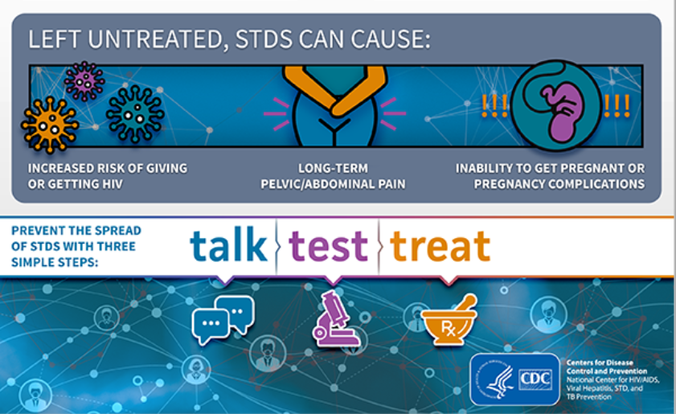
Source: CA DPH STD Control Branch
Notes:
When STI infections are not treated, they can cause serious health issues. These include increased risk of spreading HIV, long term pelvic/abdominal pain, and inability to get pregnant or complications in pregnancies.
These health effects are fully preventable. This is why it’s important to TALK with clients about STIs, encourage them to get TESTED, and to finish or continue treatment if they have an STI.
Source: https://www.cdph.ca.gov/Programs/CID/DCDC/Pages/STD-Data.aspx

Slide 13
Chlamydia and Gonorrhea
Notes:
Now that we reviewed syphilis, we will share information on chlamydia and gonorrhea.

Slide 14

Chlamydia and Gonorrhea
Bacterial infections
Most people who have them do not have any signs or symptoms.
Can be cured with antibiotics
  If untreated, can cause serious health problems including infertility, lower stomach pain, infection can spread to other parts of the body
Source: CDC. (2021). Gonococcal Infections Among Adolescents and Adults - STI Treatment Guidelines (cdc.gov)
Notes:
Gonorrhea is a curable bacterial infection.
Most people who have it , do not have any signs or symptoms. Some people with a penis who have gonorrhea can experience discharge or burning when they pee. When people with a uterus do have symptoms, they can be mistaken for a bladder infection or other vaginal infection.
Gonorrhea can be diagnosed through a urine test, vaginal, rectal, and throat swab. When speaking with clients, it is important to emphasize the importance of receiving treatment for them and their partner(s).

Slide 15

Notes:
And the distribution of gonorrhea is similar, with South Los Angeles heavily affected.

Slide 16
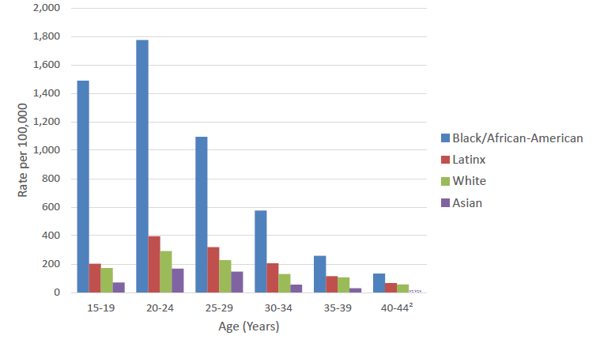
Gonorrhea Rates Among Females by Age Group and Race/Ethnicity, LAC, 2019
Source: LA DPH Division of HIV and STD Programs
Notes:
Similarly, we see an even higher disproportionate gonorrhea rate for young African American women. Now that we have looked at chlamydia and gonorrhea rates in LA county, let’s check our knowledge regarding minor consent laws.

Slide 17
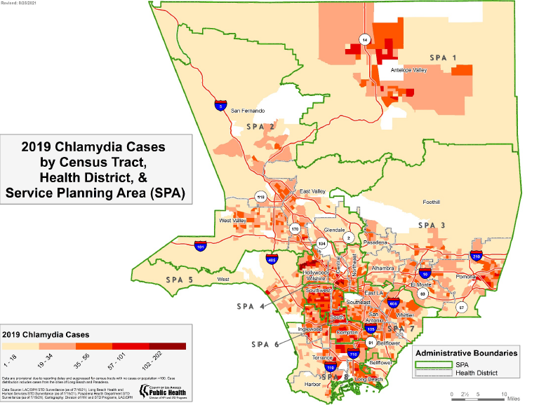
Notes:
This map demonstrates which communities in LA have the highest rates of chlamydia; as you can see, South Los Angeles is a major “hot spot” area [point on map to where clinic is located].
Because your agency provides services to young people in South LA, you’re an important partner in STI prevention.

Slide 18
Chlamydia Rates, Females by Race/Ethnicity & Age Group (in years) California, 2013
Chlamydia Rates Among Females by Age Group and Race/Ethnicity, 2017
Source: LA DPH Division of HIV and STD Programs
Notes:
*Ask participants: What stands out in this chart?
There are some disparities that are evident in the data. When reviewing chlamydia rates for females by age and race/ethnicity, we see some of the highest rates among young African American women compared to Latino, White, or Asian counterparts.
Youth of color bear a higher STI burden
Residential segregation, distinct social networks, and barriers to testing and treatment contribute to ethnic disparities
http://publichealth.lacounty.gov/dhsp/Reports/STD/2019_LAC_STD_Snapshot_051921Update.pdf

Slide 19
Potential Complications from an Untreated Infection
25%
Ectopic pregnancy
Untreated genital CT infection
20-60%
Acute PID
Silent PID
Chronic pelvic pain
18%
Infertility
Source: National Network of STD/HIV Prevention Training Centers
Pelvic Inflammatory Disease (PID) October 2011
Notes:
Untreated CT and GC infections can cause Pelvic Inflammatory Disease when the infections move up into a the uterus/reproductive tract; it causes inflammation and potentially serious scarring of the fallopian tubes, which greatly increases the risk for dangerous ectopic pregnancy or infertility, as well as chronic pelvic pain.
Acute: sudden, severe symptoms (severe pain, abnormal discharge or bleeding, fever, nausea/dizziness)
Silent: no symptoms (asymptomatic) (there is also chronic PID – milder symptoms that can be mistaken for other conditions)
Estimates of the likelihood of complications in females vary somewhat, but all studies agree that these are common problems. Chlamydia (as well as gonorrhea, and other infections) can cause PID, which in turn can lead to tubal scarring and ectopic pregnancy, chronic pelvic pain and infertility. This graphic demonstrates complications associated with CT specifically.
Most common pathogens: GC and CT are present alone or in combination in approximately 20-60% of patients; relative prevalence of these and other organisms depends on population studied. With decreasing prevalence of GC and CT, these estimates may be lower.
Approximately 25% of people with a uterus with a single episode of symptomatic PID will experience sequelae, including ectopic pregnancy, infertility, or chronic pelvic pain.
The risk of ectopic pregnancy is increased at least two-fold following pelvic inflammatory disease.
2. Tubal infertility occurs in 18% of affected people after one episode of PID, in up to 25% after two episodes, and in 40% after 3 episodes.

Slide 20
CDC Screening Guidelines
Population | Screening Recommendation
Young women (<24) | Annual screening for chlamydia Annual screening for gonorrhea
Older women (25+) and Men | Screening based on risk
Pregnant women | Syphilis, HIV, chlamydia, gonorrhea, hepatitis B and hepatitis C
Men who have sex with men | Screening at least once year for syphilis, chlamydia, gonorrhea, and HIV
*All sexually active persons 13 and older should be screened at least once for HIV.
Notes:
According to the CDC screening guidelines, sexually active young women under the age of 25 should be screened annually for chlamydia/gonorrhea. Young men should be screened based on risk factors; however, if they report male partner(s), they should be screened annually for chlamydia, gonorrhea, syphilis and HIV.
CDPH:
chlamydia – sexually active females aged <24, annually
gonorrhea – sexually active females aged <24, annually
HIV - screening one time for all sexually active
females/males; regular risk assessment to determine future screening need (e.g., injection drug users, pregnant, YMSM)
For pregnant women, the recommendation is screening for HIV (even if they have previously been tested), chlamydia, gonorrhea and hepatitis B and C during the first trimester and again during the third trimester if at high risk for HIV, chlamydia, and gonorrhea. CDPH recommends all pregnant patients be screen for syphilis at least twice, ideally during the first trimester and third trimester. Patients should also be rescreened at delivery.
Not Recommended: Routine screening of asymptomatic teens for trichomoniasis, BV, syphilis, HSV, HPV, hepatitis A virus, hepatitis B virus.
Risk factors: known/suspected exposure, new or >1 partner, possible non-monogamous partner, inconsistent condom use (<100%), personal/partner IDU, hx of prior STI diagnosis
Sources:
https://www.cdc.gov/std/treatment-guidelines/pregnant.htm
https://files.medi-cal.ca.gov/pubsdoco/publications/misc/Dear_Colleague_Letter_Expanded_Syphilis_Screening_Recommendations_12-8-20.pdf

Slide 21

Counseling for Successful Treatment
What to share with clients:
      Emphasize chlamydia/gonorrhea are sexually transmitted
      Ensure medication is taken properly
      Avoid sexual contact for 7 days after you AND your partner(s) have been treated
      Discuss all options for partner treatment
      Recommend retest in 3 months
Notes:
Part of treatment is providing strength based, client centered counseling where empowerment is the goal. Empowering patients to take chare of their sexual health can help prevent re-infection. *Have participants read all messages

Slide 22
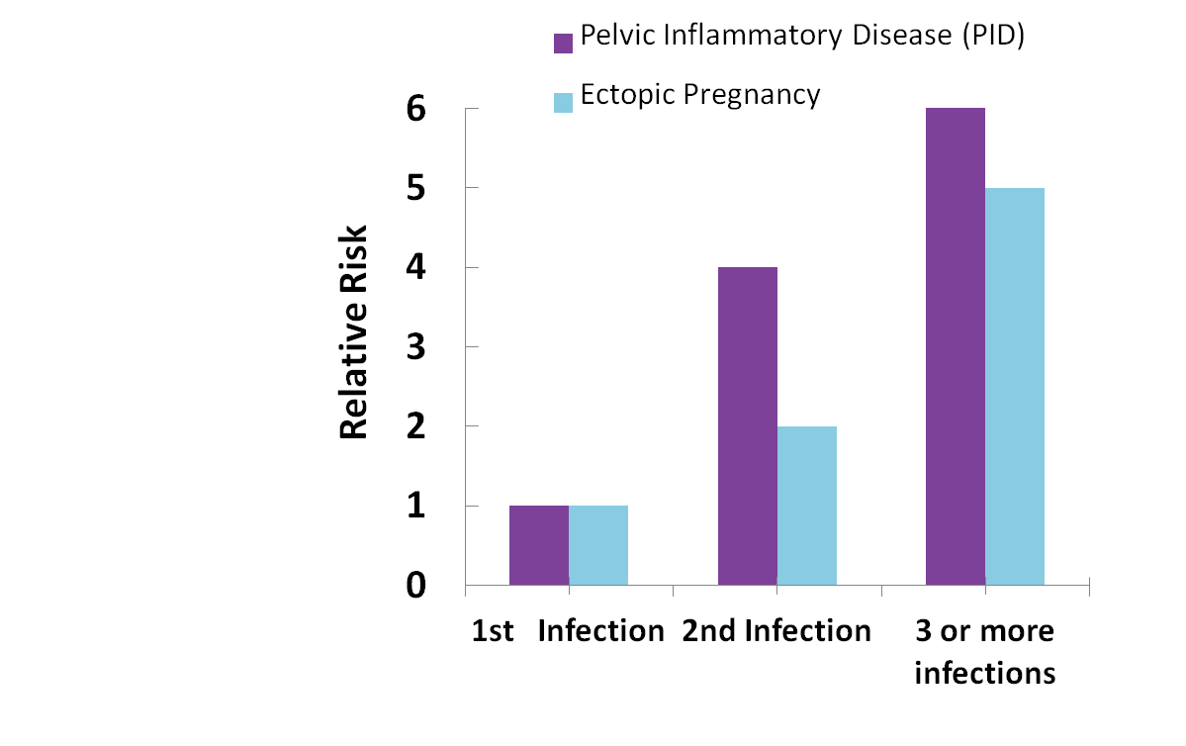
Reinfection + Potential Complications
2nd infection:
    4x risk of PID
    2x risk of ectopic pregnancy
3+ infections:
    6x risk of PID
    5x risk of ectopic pregnancy
Source: Hillis SD, et al. (1997). Am J Obstet Gynecol 176(1 Pt 1): 103-7.
Notes:
This slide shows us why reinfection with chlamydia is so dangerous and why retesting for the infection in the months following initial treatment is so important.
Repeat infection leads to a much higher risk of reproductive complications.
The graph here depicts the relative risk of a chlamydia infection leading to PID and ectopic pregnancy, depending on how many infections a woman has had. A second infection with chlamydia is 4 times as likely to progress to PID as the first infection, and twice as likely to lead to ectopic pregnancy. Three or more infections have 6x the risk of PID and 5x the risk of ectopic pregnancy.
Repeat testing within the few months following initial treatment will very likely lead to earlier detection and treatment of reinfection, which has the potential to reduce the chance of these complications developing.
And because the vast majority – generally 70-80% -- of chlamydia infections and reinfections in women are asymptomatic , it is important that retesting occurs reflexively during the recommended timeframe and is not solely triggered by patients returning to clinic with symptoms of infection.
Because there are dire consequences from repeat infections, it is important for patients to know and understand partner management. In the next few slides, we will discuss options for notifying partners.

Slide 23
Why does re-infection occur?
      Sex with untreated partner
      Sex with new partner
      Sex too soon after taking medication
      Other important factors:
      Power differential between patient & partner(s)
      Intimate partner violence
      Other socio-economic factors
Notes:
It’s important to note that not all relationships are healthy. There are real power differentials that exist between partners that may impact whether or not someone uses protection from STIs. One of the most extreme forms of an unhealthy relationship involves intimate partner violence. You may want to consult your clinic’s protocols if you discover that this is the case.

Slide 24
Partner Management Options
Treat ALL sexual partners from the 2 months prior to the positive test for chlamydia and gonorrhea
  Provider Referral
  Patient referral
  Expedited Partner Therapy (EPT)
Notes:
24
For patients positive for chlamydia and/or gonorrhea, it’s important to treat all sexual partners from the 2 months prior to the positive test. As we mentioned, syphilis partner management recommendations are based on stage.
There are a number of options for partner management. Provider referral is where health department staff, such as Disease Intervention Specialists or Public Health Investigators, notify the partner(s) of exposure and support the partner in accessing services and receiving treatment. This is typically offered for infections like syphilis and HIV. These services are referred to as partner services and are offered by the LA County Department of Public Health. These services are voluntary and confidential; patients can opt to not accept these services.
The second option is for the patient to notify their partner and it is up to the partner to access testing and treatment.
The best option is for the partner(s) to receive screening and treatment in the clinic; however, if a partner is unlikely or unable to seek clinical services, expedited partner therapy or EPT is another option through which the index patient takes a dosage of medication to their partner. EPT is legal in California for chlamydia, gonorrhea, and trichomoniasis and is covered by Family PACT and Medi-Cal.
Our agency operates an EPT distribution program for chlamydia and gonorrhea. On the next slide we will provide more information on the program.
Source: CDPH STD Control Branch, Best Practices for Prevention and Early Detection of Repeat Chlamydial and Gonococcal Infections: Effective Partner Treatment and Patient Retesting Strategies Implementation in California Health Care Settings, June 2011
**Ask participants: Are you providing prescriptions or PDPT for partner treatments? What successes or challenges have you encountered in providing partner treatment?
https://www.cdc.gov/hiv/clinicians/screening/partner-notification-services.html

Slide 25
Syphilis

Slide 26
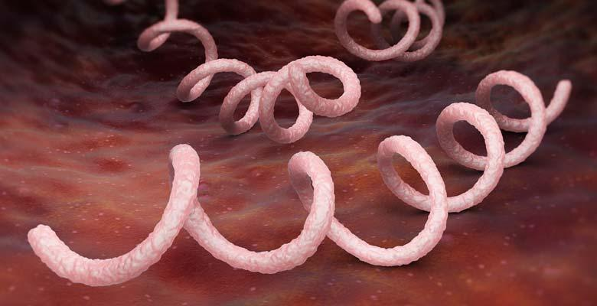
What is Syphilis?
Bacterial infection
Curable with antibiotics
Spreads through skin-to-skin contact with a sore via vaginal, anal, or oral sex
Symptoms may include a painless sore, fever, rash, or wart-like lesion
Image: Getty Images
Source: CDC and LA County DPH
Notes:
Now that we’ve completed a brief overview of the different STIs, we are going to focus in on syphilis. As mentioned earlier, syphilis infections are becoming more common. Syphilis can cause serious health issues, so reducing the spread is a major public health priority.
Syphilis is caused by a bacteria, so it is curable when treated with antibiotics.
Syphilis is spread through sustained skin contact with an infected area, usually with a sore or wart-like lesions. This can be during vaginal, anal, and oral sex. Unlike some of the other STIs, penetration or exchange of body fluids is not necessary to spread syphilis.
Sources:
https://www.cdc.gov/std/statistics/2019/overview.htm#Syphilis
http://publichealth.lacounty.gov/dhsp/Reports/STD/2019_LAC_STD_Snapshot_051921Update.pdf

Slide 27
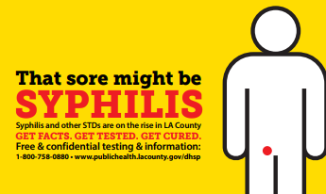
Infection Stages and Outcomes
Syphilis advances through four stages
Can cause serious, irreversible damage if left untreated
Untreated Outcomes can include:
  Nerve damage
  Organ damage
  Paralysis, dementia,
  Blindness, and/or death
Source: CDC and LA County DPH
Notes:
The infection goes through 4 stages with increasingly serious health effects.
Early stages (Primary and secondary) may include a painless sore, a body rash, a fever, and/or wart-like lesions. However, some patients do not experience or notice these symptoms.
Latent- After outward symptoms go away- usually about a year after the start of the infection- the disease goes into a Latent stage, which can have no symptoms for several years. Bacteria is still in body if there is no treatment, infecting the body
Tertiary Syphilis, or Late stage- This refers to the serious affects of long-term infection. These effects can show many years after the beginning of the infection, and can include Neurological and organ damage, blindness, deafness, dementia, even death.
While the syphilis infection is curable, the nerve and organ damage done by the infection is often permanent- This is why it is so important to test often, treat early!
Sources:
https://www.cdc.gov/std/statistics/2019/overview.htm#Syphilis
http://publichealth.lacounty.gov/dhsp/Reports/STD/2019_LAC_STD_Snapshot_051921Update.pdf

Slide 28
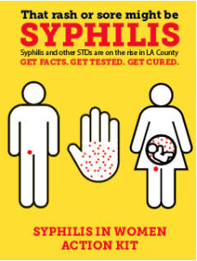
Syphilis: Key Facts
Anyone who is sexually active can get syphilis
The most common symptom of an STI? No symptoms!
Condoms can prevent most infections- but not all infections
    Skin contact that is not covered by the condom can spread the infection
Symptoms can go away while the infection stays in the body
How to know? Get tested!
Source: LA County DPH
Notes:
These are some key facts on syphilis:
Anyone who is sexually active can get an STI like syphilis
The most common symptom of an STI is No Symptoms! Many may not know they are at risk or that their sex partner(s) behavior may put them at risk.
Condoms do help prevent the spread of syphilis, but sores in places that are not covered by condoms- like the mouth or inner thigh- can spread syphilis even when condoms are used
Some people may not notice symptoms, or know that they are from syphilis. Others may hope that the infection is gone when they no longer have symptoms. Unfortunately, syphilis is still present in the body and can progress into the next stage.
The best way for someone to know if they have an STI? Get tested! We will connect you to quality, free or low-cost clinics.
Sources:
http://publichealth.lacounty.gov/dhsp/You/CongenitalSyphilisFAQ9-10-15.pdf
Image source: http://publichealth.lacounty.gov/dhsp/Providers/CS_EliminationPlan_January2020.pdf pg 35

Slide 29
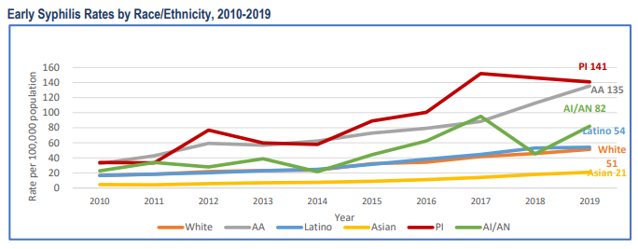
Inequalities in Infection Rates
Source: LA County DPH
Notes:
As we stated, anyone who is sexually active can get syphilis.
Unfortunately, Some groups have been more impacted by the increasing rates of syphilis than others.
As we can see from this graph, Pacific Islander, African American, American Native, and Latino residents have been more likely to test positive for syphilis than white or Asian residents.
Men who have sex with men have also been highly impacted.
These inequalities are due to many complex factors, in large part to difficulties accessing quality and consistent health care.
Source: http://publichealth.lacounty.gov/dhsp/Reports/STD/2019_LAC_STD_Snapshot_051921Update.pdf

Slide 30
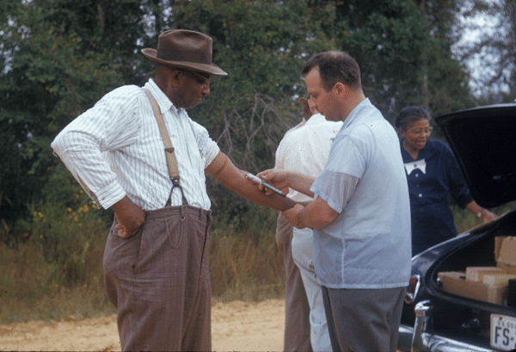
Legacy of the Tuskegee USPHS Syphilis Study: Fear and Unequal Access
1932: Researchers recruit 399 Black men with pre-existing syphilis infections for a study on the infection in exchange for free medical care. Staff withhold the diagnosis, focus of study, and risks from the men.
1943: Cure for syphilis is available but researchers withhold the cure to continue studying impact of disease on the men without their consent
1972: Study ended by whistleblower
Impact: Death and illness of the men,
their partners, and their children.
Still contributes to fear, mistrust,
and unequal access to treatment
Source: CDC Tuskegee Timeline
Notes:
When we discuss racism, health disparities, and syphilis, it is important to contextualize this issue in its history. You may have heard of the Tuskegee USPHS Syphilis Study. The study is an infamous example of medical racism and unethical research practices.
The research study began in 1932 to observe the outcomes of untreated syphilis, and the research participants were all Black men. Researchers recruited 399 Black men who already had syphilis. The participants were given free medical care in exchange for participating. The men were not informed that they had syphilis, the focus of the study, or the dangers of the study.
In 1943, When the cure for syphilis became widely available (penicillin), the medical providers and researchers purposefully withheld the cure from the men in order to continue to study the effects of syphilis on the men’s bodies. As we discussed on the last slide, those effects can be severe. This went on from 1943-1972 when the study was ended by a whistleblower.
When the study was ended in 1972, 28 participants reportedly had died of syphilis, 100 were dead of related complications, at least 40 wives had been infected and 19 children had contracted the disease at birth.
Since then, laws on informed consent and ethics review boards in research have been changed to try to prevent abuse like this from happening again, and the US Government has issued an apology and settlement. However, the mistrust and fear created by this study have continued- as well as unequal access to health care and treatment for STIs.
As we move on the discuss addressing the growing CS epidemic, it is really important to keep this history in mind.
Source: https://www.cdc.gov/tuskegee/timeline.htm
https://www.tuskegee.edu/about-us/centers-of-excellence/bioethics-center/about-the-usphs-syphilis-study
https://www.tuskegee.edu/about-us/centers-of-excellence/bioethics-center/impact-on-healthcare
https://www.latimes.com/archives/la-xpm-2004-jan-25-me-hendon25-story.html

Slide 31
Racism and Inequity: Root Causes
Studies show that differences in individual and group risk behaviors do not explain inequities in STI infection rates
Racism and structural inequity root causes
Disparities in preventative care, testing, and treatment continue at a structural level
Source: Science Direct
Notes:
When we see statistics with some groups of people of color having higher rates of STIs, it is important that we remember: Studies show that differences in rates of STIs across race are not explained by behavior differences at the individual or population level.
This means that an African American or Latina woman with similar lifestyle factors to a white woman is still more likely to be exposed to STIs like syphilis, and less likely receive quality health care to address the infection.
High rates of sexually transmitted infections have always been related to a complex web of social issues- including housing, incarceration, and stigma.
At the center of that web, Racism and structural inequities are root causes of the disparities in STI infections.
Source:
https://www.sciencedirect.com/science/article/pii/S1755436515000080

Slide 32
Syphilis Screening Recommendations
Population | Recommendation
Pregnant people | First prenatal visit Third trimester (28-32 weeks) At delivery
Patients who can become pregnant | At least once Additional testing based on risk
MSM/MSMW | Annually Additional testing based on risk
Trans women | Annually Additional testing based on risk
HIV + (all genders) | Annually Additional testing based on risk
Source: California Department of Public Health
Notes:
One important clinical best practice is adhering updated screening guidelines in order to detect syphilis cases and provide treatment as soon as possible.
These are the CA Department of Public Health screening recommendations for syphilis, which were released at the end of 2020. [Go over each recommendation]. Ask: What are risk factors that would prompt additional screening?
Examples of risk factors that would prompt additional screening include having multiple sexual partners, sex with no condoms or other barriers, and sharing needles for any purpose. On the next slide, we will look at other risk factors.
Source:
https://www.cdph.ca.gov/Programs/CID/DCDC/CDPH%20Document%20Library/Dear-Colleague-Letter_Expanded-Syphilis-Screening_12-8-20.pdf
https://www.cdph.ca.gov/Programs/CID/DCDC/CDPH%20Document%20Library/Expanded-Syphilis-Screening-Recommendations.pdf

Slide 33
Factors that Prompt Additional Testing
  New sex partner or multiple sex partners
  Sex partner with known or suspected other partner(s)
  Substance use disorder, particularly intravenous drug use/methamphetamine use
  Recent incarceration or sex partner who was recently incarcerated
  Experiencing homelessness or unstable housing
  Exchanging sex for money, shelter, or other things
Diagnosis of another STI in the last 12 months
HIV infection
Source: CDPH Expanded Syphilis Screening Guidelines, 2020
Notes:
Every sexually active person should be tested for STIs including Syphilis at least once, with additional screening based on behavioral factors. These are factors on this slide are associated with syphilis infection. [Read risk factor list]. It’s important to conduct routine sexual histories with your patients to identify factors like these that would prompt the need for additional testing.
Source:
https://www.cdph.ca.gov/Programs/CID/DCDC/CDPH%20Document%20Library/Expanded-Syphilis-Screening-Recommendations.pdf
https://www.ncsddc.org/wp-content/uploads/2019/04/Syphilis_Monograph_2019-NYC-PTC-NYC-DOHMH.pdf
http://publichealth.lacounty.gov/dhsp/Providers/CS_EliminationPlanDraft_01282020.pdf

Slide 34
Congenital Syphilis
Notes:
Now that we’ve covered the growing rate of syphilis, lets take a look at a very connected and alarming trend: increases in congenital syphilis.

Slide 35


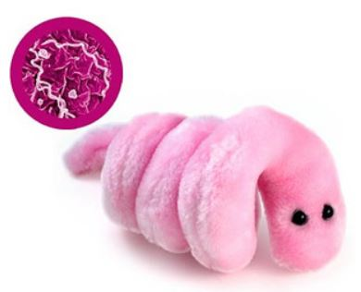
What is Congenital Syphilis (CS)?
CS is transmitted from the pregnant person to the fetus during pregnancy or delivery.
Notes:
We know that syphilis infection usually stays in the body unless the person is treated with antibiotics. What happens when someone with syphilis becomes pregnant?
Syphilis infection can be passed from the pregnant person to the developing fetus during pregnancy or spread to the newborn during delivery.
This is called Congenital Syphilis, or CS
Congenital means a condition present from birth. You may have heard of this term in congenital heart defects. Congenital refers a health issue that is formed while in the womb that a newborn is born with.
CS is curable and preventable. If all pregnant people or those who are trying to become pregnant are tested, treated, and linked into prenatal care, we may reduce congenital syphilis rates and it's devastating effects.
Let's take a look at the effects of CS.

Slide 36
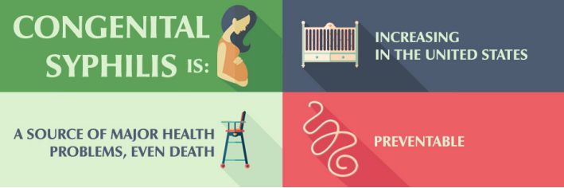
Outcomes of Congenital Syphilis
Miscarriage, stillbirth, infant death
Premature birth, Low birth weight
Birth defects including:
  Deformed bones, severe anemia,
  enlarged liver and spleen, jaundice,
  blindness or deafness, meningitis
Preventable with testing, treatment, and prenatal care
Source: CDC
Notes:
CS is preventable, but the impact of CS can be very serious.
Untreated Syphilis during pregnancy can cause adverse pregnancy outcomes, including:
Miscarriage (loss of the pregnancy), Stillbirth and infant death occur in roughly 40% of infected infants when not treated
Prematurity (births that occur too early),
Low birth weight (defined as when a newborn weighs less than 5 and a half pounds)
Other health consequences of congenital syphilis in the newborn include:
Deformed bones, severe anemia, enlarged liver and spleen, jaundice, blindness or deafness, meningitis
These serious health issues are preventable by preventing syphilis during pregnancy, and by testing for and treating syphilis while someone in pregnant. Early, thorough treatment during pregnancy is effective at preventing CS- which is why early, ongoing prenatal care is so important.
Sources:
https://www.cdc.gov/nchhstp/newsroom/2019/2018-STD-surveillance-report.html
https://www.cdc.gov/nchhstp/pregnancy/effects/syphilis.html#:~:text=Approximately%2040%25%20of%20babies%20born,%2C%20meningitis%2C%20or%20skin%20rashes.

Slide 37
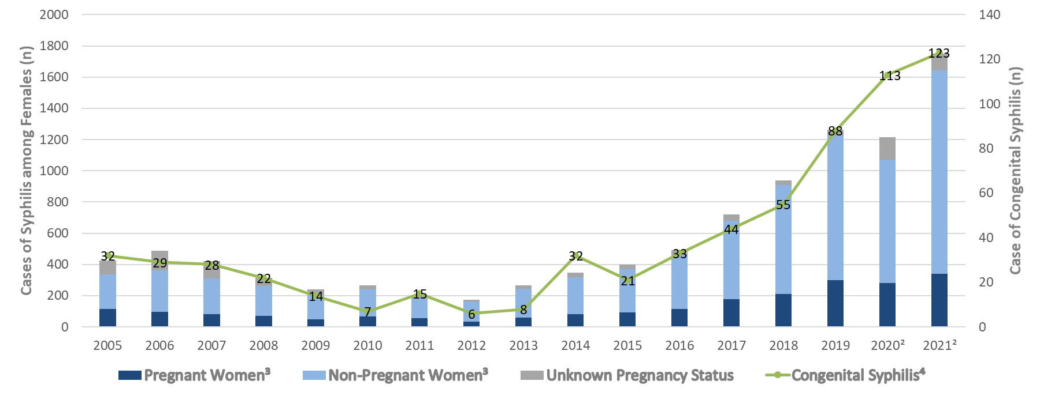
Number of Female and Congenital Syphilis Cases, Los Angeles County, 2005-2021
Source: LA DPH Division of HIV and STD Programs
Notes:
This graph shows the increases in syphilis and CS among female patients in LA county between 2005- 2021
The bars represent female cases of syphilis. The dark blue portion represents the proportion of pregnant women, while the light blue represents non-pregnant women.
The green line shows the cases of congenital syphilis. Since 2012, the number of reported congenital syphilis cases has drastically increased.
In 2020, Syphilis cases did not rise, which may be due to delays in testing and medical care during the beginning of the Covid-19 pandemic.
From 2012 to 2021 congenital syphilis cases rose from 6 cases to 123 cases.
These numbers are staggering considering how preventable CS is and how serious the health outcomes are for the disease.
This graph shows the importance of access to reproductive health care services, adequate screening, and timely treatment for females in order to address the rise in congenital syphilis.
Source: Provided by LA County DHSP February 2022
Graph notes:
¹ 2005-2021 data are from STD Casewatch as of 07/29/2022 and exclude cases from Long Beach and Pasadena ² 2020-2021 data are provisional due to reporting delay. ³ Syphilis among females of childbearing age (ages 15-44) including all cases staged as primary, secondary, early non-primary non-secondary (previously early latent) and unknown duration/late (previously late latent) ⁴ Congenital Syphilis includes syphilitic stillbirths

Slide 38
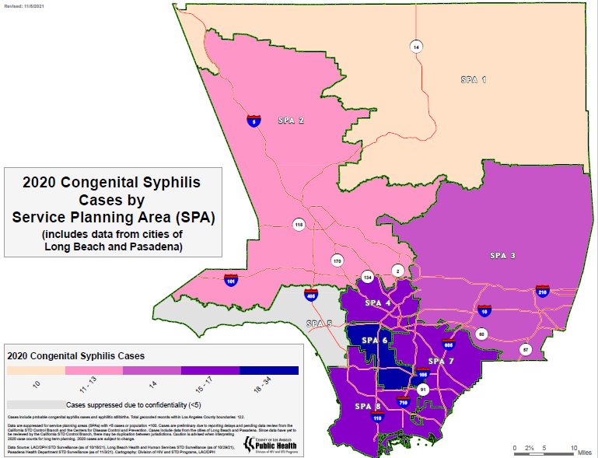
Source: LA DPH Division of HIV and STD Programs
Notes:
On this map of LA County, we can see cases of CS by LA County’s Service Planning Areas, or SPAs, in the year 2020.
SPA 6, or South LA, had the highest concentration of CS births. Spas 4, 7, and 8 all also had higher numbers of cases- which are South Bay, Metro LA, and East LA communities.
Because your agency provides services in these areas, you are an important partner in preventing CS.
Source: Provided by LA County DHSP February 2022

Slide 39
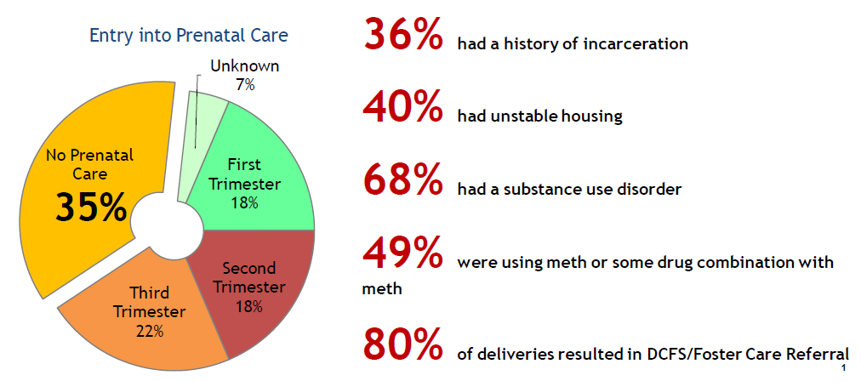
Congenital Syphilis Trends:
2019 Birthing Parent Case Analysis
Source: LA DPH Division of HIV and STD Programs
Notes:
What do we know about the birthing parents of infants diagnosed with congenital syphilis in LA County?
LA County DPH analyzed the 88 cases of CS in 2019 and found several trends.
The vast majority either did not have any prenatal care, started prenatal care late in the pregnancy, or were poorly engaged in prenatal care. This is very important because as we have shared, prenatal care is where CS can be tested for and treated.
Many birthing parents experienced competing life challenges such as homelessness, poverty, lack of access to health care, and/or interaction with the criminal justice system.
68% had a substance use disorder during pregnancy
49% using methamphetamine during the pregnancy
We also see a very high rate of foster care referrals at birth
All of these factors can impact client’s ability to access health care, including prenatal care.
LA County has identified service providers like yours as key partners to reach clients with these factors who may not otherwise be engaged in reproductive health care.
Source:
http://publichealth.lacounty.gov/dhsp/Providers/CS_EliminationPlanDraft_01282020.pdf
http://publichealth.lacounty.gov/owh/OWHConferences/TimeisNow2019/ShobitaCongenitalSyphilis.pdf
Image and data Provided by LA County DHSP February 2022

Slide 40
CS and Racial Justice:
Birthing Parent Case Analysis 2018
Source: LA County DPH
Notes:
A study of CS birthing parents in 2018 also found serious health disparities along the lines of race. African American and Latina women were disproportionately likely to be impacted by congenital syphilis. Out of all of the people who gave birth infants with CS in this year, 62% were Latina, and 32% were African American.
When we connect these racial health disparities in syphilis to reproductive justice, we see a bigger picture.
There is a long history of mistreatment of women of color in the US- not just in terms of having equal access to reproductive health care, but also in terms of being able to grow families in chosen ways, to give birth safely, and to be able to parent.
Examples of this include:
The forcible sterilization of Latina women here in Los Angeles at LAC-USC Medical Center in the 60’s and 70’s.
Higher rates of maternal mortality for Black women in the US than their peers.
Police violence against children of color further violates the right to live safely, and to parent in a safe, healthy community.
It is not acceptable that women of color and their children are more likely to face the impacts of congenital syphilis.
As we reckon with this reality, we can all do our part to address these inequities.
Source:
https://www.sciencedirect.com/science/article/pii/S1755436515000080
https://www.washingtonpost.com/news/arts-and-entertainment/wp/2016/01/10/sterilized-against-their-will-in-a-los-angeles-hospital-latinas-tell-the-story-in-a-new-film/
https://www.hsph.harvard.edu/magazine/magazine_article/america-is-failing-its-black-mothers/
Source:
http://publichealth.lacounty.gov/owh/OWHConferences/TimeisNow2019/ShobitaCongenitalSyphilis.pdf
https://www.sciencedirect.com/science/article/pii/S1755436515000080

Slide 41
Barriers to Care
Notes:
We will now discuss the barriers and inequalities that have shaped the impact of CS. This information is designed to give you information and context to support clients.

Slide 42
Poll: Go to www.menti.com
What barriers to sexual and reproductive health care could your clients be experiencing?
Answer are anonymous and will be displayed to the group
Notes:
As we think about these factors, we’d like to hear your thoughts on what barriers your clients might be experiencing.
With an internet browser on your phone or computer, Go to www.menti.com and enter code 9805 8982. You can submit multiple answers, and while answers will be shared, writers will be anonymous.
What are some barriers to accessing sexual and reproductive health care that your clients could be experiencing?
[Share using: https://www.mentimeter.com/app/presentation/6143fb0ec6edbf59d4d50af3156b7bd2/8592828d4270
[Action: Read over potential barriers shared in the chat. Answers may include: Stigma, money, transportation, fear, disrespect, racism, mental health, ]
Thank you for sharing. Multiple barriers may intersect to make a even more complex issues. Let’s keep these in mind as we consider how to start pregnancy intention questions and supporting clients for linkage to care.

Slide 43
Understanding Barriers to Reproductive Care for People with CS- Associated Factors
Stigma
Competing high-priority concerns
Structural barriers- access, finances, transportation, etc.
Lack of knowledge on reproductive health
Fear of Child Protective Services and law enforcement
Abusive or controlling partner
Sources: MacAfee et al, Chan et al.
Notes:
Thank you again for sharing barriers that you have heard from your clients.
Here are some of the top barriers reported by people with factors associated with CS. These are taken from research studies.
[Read over barriers]
As we consider how to help clients overcome these barriers, lets remember that these concerns are not unfounded.
While substance use during pregnancy is not a mandated report to DCFS in CA, we did see the high rate of DCFS referrals and foster placements at birth among CS infants and their birthing parents.
Fear of separation from children or criminal charges for substance use are reported to be a reason for some people to avoid health care.
Unfortunately, avoiding health care can further separate people from supportive services and can allow preventable health conditions like CS to go untreated.
With these very real concerns, it is important that we focus on supportive services to improve outcomes for parents and infants.
Source:
https://www.tandfonline.com/doi/abs/10.1080/10826084.2019.1656255?journalCode=isum20
https://journals.plos.org/plosone/article?id=10.1371/journal.pone.0249419

Slide 44
Reframing: Language and Perspective
Stigmatizing Language | Reframing Language
“Clean” | Negative for STIs, or substance free, in-recovery
Addict, junkie, user, drug abuser | Person with a substance use disorder
Non-compliant | Has significant barriers to care / taking medicines
Service-resistant | Has unmet needs and unaddressed barriers
Seidman, Dominika MD MAS. (2019). How can we eliminate congenital syphilis in the context of a broken reproductive healthcare system?
Notes:
A trauma informed practice includes reframing how we think about and talk about clients who may be labeled “Difficult.” On the left, you see commonly used language that can be very stigmatizing to use with patients. Instead of using the words on the left, there is alternative language we can use and model for our patients. Using non-stigmatizing language is one way we can build rapport with patients, and identify ourselves as a non-judgmental resource for them.
Source:
Offering services to women who are unstably housed or homeless (essentialaccess.org)

Slide 45

Breathe, Share, or Stretch
Optional debrief Question:
What thoughts or feelings does our discussion of the rise of congenital syphilis bring up for you?
Image of Kenneth Hahn Park by Nicole Handley.
Notes:
We want to take a moment to recognize how talking about reproductive injustices can impact us. If you notice feelings, thoughts, or sensations are coming up for you, it is understandable to have a response when discussing injustices and the cumulative impact it can have on us as people doing the work.
This impact can be because the topics relate to your own life experience, or through second-hand stress.
Let's take a moment to take care of ourselves. How can we take steps to restore ourselves so we can continue our collective efforts?
This is an invitation to acknowledge and move through this in the way that works best for you. It can look like moving away from the screen, taking a few stretches where you are, taking deep breaths or expressing it out loud.
If you would like to share, what do these topics bring up for you? [(PAUSE FOR RESPONSES, thank for sharing)]
[ If no response:] Feel free to take a 5 minute break. [Presenters] will stay on in case anyone is interested in participating in a grounding exercise, please raise your hand if you will be staying ON. We will regroup at (+ 0:05).
For folks who are ON, for next 4 minutes, we will connect to our breathe following the audio and visual cues in the following video from The School of Self channel on youtube. [ Share video: https://youtu.be/aXItOY0sLRY return to powerpoint once 5 minute have passed]
Thank for staying on!
If you find it helpful, take a slow, deep breathe. Consider looking away from the computer screen to give your eyes a break. Do you feel where is this coming up in the body, you can put you hand over that and breath,
Thank you for sharing
Source:
Photo provided by Essential Access staff member Nicole Handley with permission to use.

Slide 46
Asking Pregnancy Intention Questions
Notes:
Welcome back, please let us know you're with us by putting an emoji for how you're showing up, you can go on camera or even thumbs up. [Acknowledge responses as they appear]
We now know the importance of discussing pregnancy intentions and prenatal care earlier to help reduce CS rates. Let's discuss how to present questions and assist our clients, while keeping in mind the barriers they may face.

Slide 47
Poll: Go to www.menti.com
How comfortable do you feel asking your clients questions about their pregnancy intentions?
Very comfortable
Somewhat comfortable
Neutral/Unsure
Somewhat uncomfortable
Very uncomfortable!
Notes:
As we start this section, we want to know how you feel (comfort level) about asking your clients about their pregnancy intentions.
With an internet browser on your phone or computer, Go to www.menti.com and enter code 9805 8982.
Please submit your answer to this question. Your answer is anonymous but the results will be displayed. Let us know- do you feel very comfortable? Neutral? Or uncomfortable?
[Action:
Display results on screen for participants to view at https://www.mentimeter.com/app/presentation/6143fb0ec6edbf59d4d50af3156b7bd2/8592828d4270 ]
The poll responses are anonymous and there are no right or wrong answers. So, please feel free to share your answers. .
[Discuss results]: Looks like most people are comfortable/ uncomfortable,
If you feel very comfortable talking with clients about reproductive health, that’s great! If you feel very uncomfortable with the topic, that’s normal and ok too. We are going to give you tips, tools, and practice so that you can get much more comfortable having these important conversations.

Slide 48
How do we start the conversation?
Transition into the topic, connecting the client’s stated needs to their overall sexual and reproductive health.
Normalize the assessment (“I ask all my clients…”),
Acknowledge that the questions may feel personal, and explain that you’re asking them so you can provide the best care possible.
Source: FPNTC
Notes:
Here are steps to starting a successful conversation on sexual and reproductive health based on the Providing Quality Family Planning Services
Recommendations of the CDC and the U.S. Office of Population Affairs
Transition into the topic
It’s helpful to connect the client’s stated needs to their overall sexual and reproductive health.
Normalize the topic
Using the phrase “I am asking all of my clients” to normalize and keep the conversation comfortable for both client and provider. Make an effort to ask all clients.
3. Acknowledge that the questions may feel personal, and explain that you’re asking them so you can provide the best care possible.
Source: https://rhntc.org/sites/default/files/resources/supplemental/fpntc_qfp_std_5p_crd_2015.pdf
https://rhntc.org/resources/sexual-health-assessment-job-aid

Slide 49

Tips for Discussing Reproductive Health
Practice beforehand
Be aware of your body language
Empathize and validate
Use open-ended questions that cannot be answered yes or no
Ask, don’t guess about client’s sexual orientation, gender, and behaviors
Use inclusive terms like “partner” instead of boyfriend/girlfriend
Source: CDC Division of HIV Prevention
Notes:
These tips may help you to discuss these sensitive topics with your clients.
Practice beforehand- If you are comfortable, you can better help the client to feel comfortable. We will practice today during this training to help you get started.
Be aware of your body language- practice open, caring body language. Try to relax and not react even if someone says something that surprises you. Our body language can communicate a lot to a client and we want to be mindful not to display body language that can shut the conversation down or make the client uncomfortable.
Use Open Ended Questions- When asking about pregnancy, open ended questions can help the client to share more information, and help them to focus the conversation on what is important to them rather than what the provider/staff may see as most important.
Empathize and Validate- When clients share about a feeling, or behavior, letting them know that you understand why they would feel or react that way can go a long way to develop trust. Reflect back what was said to ensure you understand and display your understanding.
Avoid assumptions- we need to be very careful to avoid assumptions based on appearance, relationship status, age, gender, or other factors. Asking is the only way to know about someone’s true gender, sexual orientation, and sexual behaviors.
Using inclusive terms like “partner” help to avoid assumptions about gender, sexual orientation, and relationship status
Source: https://www.cdc.gov/hiv/clinicians/screening/discussing-sexual-health.html
PATH Handout_072319.indd (rhntc.org)

Slide 50
Rephrasing Counseling Questions
Instead of “Do you use condoms every time?”
Say: “How often do you use condoms?”
Instead of “Have you considered an IUD?”
Say:______________________________
Instead of “Aren’t you worried about getting an STI?”
Say:______________________________
Notes:
Let’s practice creating open ended questions with non-judgmental language.
We could ask, “Do you use condoms every time?”
This would probably only bring a yes or no answer- and it sets the bar high, and may make some clients feel pressured to say “yes” even if that’s not completely accurate.
Asking “How often do you use condoms?” instead encourages clients to share more information, and gives space to share challenges.
Ok, now it’s your turn to practice. Feel free to put your ideas in the chat-
What’s not so great about asking, “Have you considered an IUD?”
(Read over chat answers. Answers may include, it’s a yes or no question, it puts pressure on the clients, or its actually ok)
Depending on the context, this question can be advice masquerading as a question.
What might we ask instead?
“What have you heard about IUDs? Or “How do you feel about IUDs?”
What’s not so great about “Aren’t you worried about getting an STI?”
How might a client feel about being asked this question?
It may make the client defensive and shut down the conversation.
Seems judgmental and shows a negative assumption about the client- instead of building on their strengths.
Instead we could say: “What are you doing to protect yourself from STIs?”
Great job everyone, and thanks for sharing ideas.

Slide 51
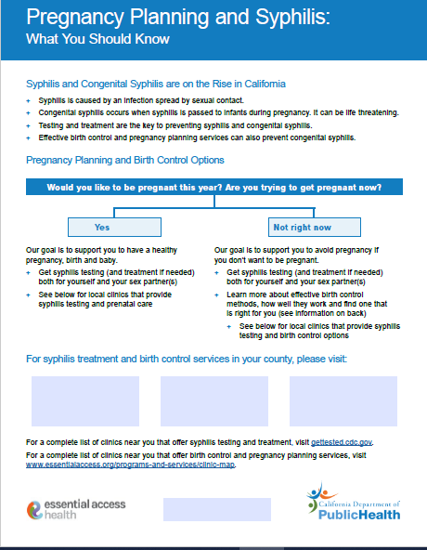
New Interaction Tool w/ Referrals
Congenital Syphilis in CA – the FACTS!
Pregnancy Intentions Script + Counseling Messages
Integrated Referrals (Syphilis Testing + Reproductive Health Care)
Notes:
As we go to go over how to ask pregnancy intentions questions, provide referrals, and give an overview of birth control options, remember: This information is all included in the tool we are providing for you. This can be used as script and as an informational hand-out.
The top section has information about congenital syphilis.
The middle section has the pregnancy intention questions and next steps for a person based on their answer.
The bottom 3 boxes are spaces to add the clinic sites that provide the integrated services.
There are weblinks at the bottom to find syphilis testing and treatment sites and family planning sites in California. These should be considered a back up to the integrated referrals above it.

Slide 52
Pregnancy Status
(Postpartum)
Pregnancy Intention
“Do you think you would like to have more children in the future?”
“How important is it to you to prevent pregnancy
(until then)?”
“Are you
(or your partner) pregnant now?”
Source: CDC STI Guidelines 2021
Notes:
*** For Postpartum period***
In order to support client’s pregnancy goals, we need to ask about both their pregnancy status and their pregnancy intentions.
On the left in blue is an example of how to ask a client about their pregnancy plans or desires. “Do you think you would like to have (more) children in the future?”
“How important is it to you to prevent pregnancy (until then)?”
Ways to ask about pregnancy status are on the right in green “Are you pregnant now?” “Could you be pregnant?
It is important to ask these questions in a value-neutral way and to respect the intentions of the person. We need to not assume, or make a judgment, on whether someone wants to or should have children- that it their own decision.
While not all of these particular questions are open-ended, you can follow them with open ended questions to learn more about the person’s pregnancy intentions and needs.
Source: https://www.cdc.gov/std/treatment-guidelines/STI-Guidelines-2021.pdf Pg. 3

Slide 53
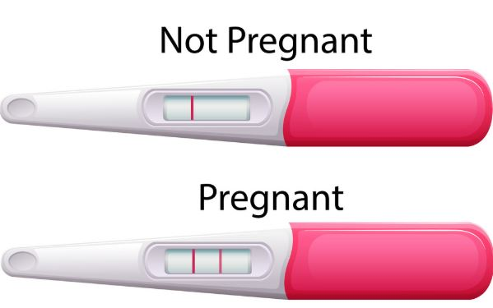
Postpartum: Is Pregnancy Status Unknown?
Have they had sex (that could cause pregnancy) since the start of their last period?
Was their last period over a month ago?
  Encourage pregnancy testing
  Refer to site with free syphilis testing and treatment + free pregnancy testing
Source: CA DPH and US DHHS
Notes:
When asking pregnancy status and intention questions, we may find that some clients may not know if they are pregnant or not.
Some follow up questions could be:
Do you know approximately when you last had sex that could cause a pregnancy?
Have you had your period in the last month?
If their period was more than a month ago and they had sex that can lead to pregnancy since then, there is a chance that person could be pregnant.
Note: some types of birth control or health conditions may cause irregular periods or stop periods. Encourage consulting with health care provider.
Assisting a client to test for pregnancy at their visit is encouraged. This could be done immediately by giving them pregnancy urine test sticks and explaining how to use them. The other option is to refer them to a clinic that will test them for pregnancy as well as syphilis.
It’s also important to provide information on the dangers of congenital syphilis and the importance of prenatal care if they are pregnant and plan to continue the pregnancy.
Source: https://www.hhs.gov/guidance/sites/default/files/hhs-guidance-documents/QFP%202017.pdf
https://www.cdph.ca.gov/Programs/CID/DCDC/CDPH%20Document%20Library/Expanded-Syphilis-Screening-Recommendations.pdf

Slide 54

If Pregnancy Not Desired…
GOAL: avoid pregnancy
Ask if you can share contraceptive options
Explain risk of congenital syphilis
Emphasize importance of getting tested
Referral to confidential syphilis testing + free contraception
Source: CDC STI Guidelines 2021
Notes:
What if the person tells you they do NOT want to get pregnant or have a baby anytime soon? Or they do not want their partners to get pregnant?
Stay neutral and non-judgemental. Let them know without telling them what to do:
Our goal is to assist you in avoiding pregnancy if you do not wish to become pregnant.
Share general information on their birth control options. You don’t have to be an expert. We’ll be going over a tool that can help support with this.
Discuss the rising risks of syphilis and congenital syphilis. Encourage testing.
Provide a referral to an integrated health center where patients can receive contraceptives, syphilis testing, and treatment if needed. You can still give them information on congenital syphilis, preconception and prenatal care because their or their partners pregnancy status or intentions may change.
Source: https://www.cdc.gov/std/treatment-guidelines/STI-Guidelines-2021.pdf
http://publichealth.lacounty.gov/dhsp/Providers/CS_EliminationPlan_January2020.pdf

Slide 55

If Pregnancy Desired or Possible…
GOAL: healthy birth / baby
Emphasize need for testing and early, continued prenatal care
Explain risks of congenital syphilis
Provide referral to confidential treatment and preconception / prenatal care
Source: CDC STI Guidelines 2021
Notes:
What if your client tells you they do hope to get pregnant or want to be pregnant soon?
In a neutral, non judgmental, non directive, unbiased manner, explain:
Your goal is to help them get the information they need to have a healthy baby.
The need for testing and early, continued prenatal care throughout a pregnancy
The risks of congenital syphilis and the impact it can have on pregnancy.
Be ready to connect them with a convenient health site that provides syphilis treatment as well as preconception and prenatal care.
Have information such as pamphlets or posters on the wall, readily available to share with clients to help them begin care or get tested as soon as possible.
Source: https://www.cdc.gov/std/treatment-guidelines/STI-Guidelines-2021.pdf
http://publichealth.lacounty.gov/dhsp/SyphilisInWomen/4_Syphilis-in_Women_Update_For_Healthcare_Providers_Master_jch_1-21-20_FINAL.pdf

Slide 56

Gender and Pregnancy Questions
Ask people of all genders- including cisgender men and transgender people
Partners who cannot get pregnant are important in CS prevention
Answers can lead to providing condoms, access to syphilis testing, and prenatal or contraceptive care for themselves or their partner
Source: CDC STI Guidelines 2021
Notes:
It’s important to ask about the pregnancy status and intentions of people of all genders, including cisgender men and transgender people. The questions are framed to be gender neutral.
Partners who cannot get pregnant, but who can cause a pregnancy, have an important role in preventing CS.
You can follow these questions with open ended questions to find out more about the client’s goals and needs. For instance, you can ask, “What are you doing to help prevent pregnancy?” or “What are some things you’re doing to prepare for a healthy baby?” depending on their desires.
The answers to these questions can lead you to helping them get access to condoms, syphilis testing, and prenatal or contraceptive care for their partner.
One issue that can come up when talking to clients about their partner’s pregnancy intentions is control. Sometimes it is useful to remind clients that they can make decisions for their own bodies, but they don’t get to make decisions for other people’s bodies. Someone should never pressure another person to get pregnant, to end a pregnancy, or use a particular type of birth control or sterilization.
Source: https://www.cdc.gov/std/treatment-guidelines/STI-Guidelines-2021.pdf pg. 3

Slide 57
Pregnancy Status v. Intention Role Play
Please open the Google Drive link in the chat to access the practice activity directions!
Enter the breakout rooms
Choose one person to be a staff member and one to be a client
Practice via the script
Notes:
Now let’s take some time to practice!
We will share a link to a google document in the chat. Please open it so that you are access to the activity.
[Share in chat: https://docs.google.com/document/d/1Fqm0Zae5-P3WcM3sV9JcDJnV5hs8E4EM1WQ2yom4IPk/edit?usp=sharing ]
I am going to put you into breakout rooms. In these rooms, one of you will play the client, Casey, whose details are in the document.
Another person will be the staff member working with Casey, having just finished up a routine interaction with her.
Role play to practice how you would open a conversation on pregnancy intentions, and how you would respond.
You can also brainstorm with your group on other intention questions you could ask. This is not an all inclusive list and your questions will vary based on the population you are working with. If you are playing Casey, think about how it might feel to be asked these questions, and what you need to feel comfortable.
I will give you 5 minutes to practice, then you will switch roles. Once the activity is done, we’ll all meet back in the main zoom room to debrief.
[Put participants into break rooms, check in break rooms]

Slide 58
Welcome back!
Report back: How did it go?
Client information:
Casey, 25 year old cisgender woman, 1 child age 6 mo, engaged
Date of last period: 1 month and 4 days ago
Uses condoms sometimes, can’t afford to buy birth control
Wants to have another child when 27-28 (in 2-3 years)
Has a new job and wants to get stable housing before having a second child
Notes:
[Action- close breakout rooms after practice time is over)
Welcome back, everyone. Thanks for practicing. Let’s have someone from each group share how they asked the questions. Breakout group 1, let’s have you go first. If there was somewhere you felt stuck or unsure, we can brainstorm together how to help.
[Unmute group members, have them discuss their experience].

Slide 59
Referrals + Resources
Notes:
Now that we’ve discussed how to talk about pregnancy intentions with your clients, let’s talk about making integrated referrals and supportive resources.

Slide 60

Quality Care
Everyone deserves health care that is:
Private and confidential
Respectful and non-judgmental
Clearly explained in the patient’s preferred language
Answers any questions or concerns
Centers client consent and right to make decisions based on their own values and in their own best interest
Source: NCSH- Sexual Health Guide
Notes:
As we have discussed, there are many barriers to accessing sexual and reproductive health. One barrier that studies show has affected birthing parents of CS is fear of (and previous experiences of) mistreatment, judgement, discrimination, and even criminalization in medical care.
Mistreatment in medical care is not acceptable. All patients deserve high quality care, which includes the factors on this slide. As community-based providers, we can support clients by validating their concerns, informing them on their rights, and assisting them to navigate health care. If your client does experience mistreatment or discrimination, a good first step is to empathize with them, and validate that this was wrong. Next, you can offer to help them file a complaint with the patient services department of the organization, the applicable board or governing body for the provider, or the office of civil rights.
Sources:
NCSH-Sexual-Health-Guide-National.pdf (ncshguide.org)
https://journals.plos.org/plosone/article?id=10.1371/journal.pone.0249419#sec007
https://www.ncbi.nlm.nih.gov/pmc/articles/PMC5151516/
https://familypact.org//wp-content/uploads/2019/12/PatientRights_ENG.pdf

Slide 61
Advocacy:
Helping Clients Prepare for their Visit
Assisting clients to prepare their questions and concerns can help them to feel more comfortable and to get the most out of their visit
Questions clients may want to ask include:
What is your privacy/confidentiality policy?
What is the cost to me? What funding programs do I qualify for?
What tests do you recommend?
How and when will I get my results?”
Source: NCSH- Sexual Health Guide
Notes:
If a client is interested in accessing reproductive care but is nervous or unsure of how the visit might go, it can be helpful to assist them to prepare.
Clients may benefit from preparing their questions and concerns beforehand- including even writing them out on paper. Clients who are uneasy with or unaccustomed to the medical system also may benefit from practicing answering questions that a receptionist or provider might ask.
Quality care is sensitive to any questions or concerns a patient might have.
For a list of questions that clients could consider, see source:
Source: https://www.ncshguide.org/downloads/NCSH-Sexual-Health-Guide-National.pdf

Slide 62


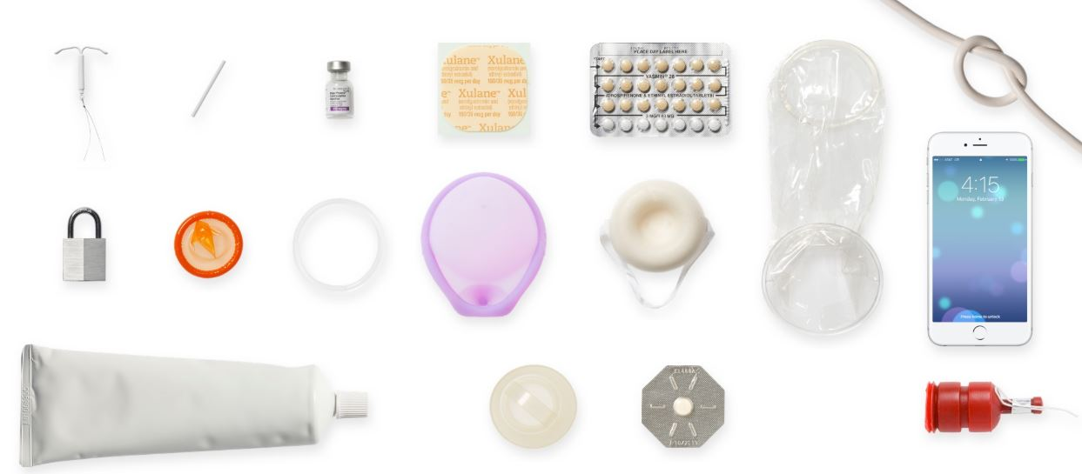
Treatment + Family Planning Sites
Syphilis Testing + Treatment
Prenatal Care
Birth Control Methods
Notes:
Best practice is to give an integrated referral from our list of full service providers.
This means a person can get everything done at one health site and in one visit:
They can get tested and treated for syphilis and other STIs
If pregnant or trying to become pregnant, they can access prenatal care
If they want to avoid pregnancy and wish to start a contraceptive method, they can do that too.
We know the fewer stops a person has the make, the more likely they are to access ALL the care that they need.
It’s important to make sure that syphilis treatment and family planning services are available at the clinics where you are referring patients to. We are providing your agency a list of clinics that provide these services, and creating a direct referral link.
If you need to refer to other clinics, please make sure not to assume that all health sites, planned parenthoods or STI testing facilities provide syphilis treatment, prenatal care and birth control methods.
Even though there are many clinic locator apps available to find local health clinics, you still need to check them out to confirm if they provide these integrated services. We can help support with identifying additional clinics if you have a client unable to visit the clinics on the list.

Slide 63
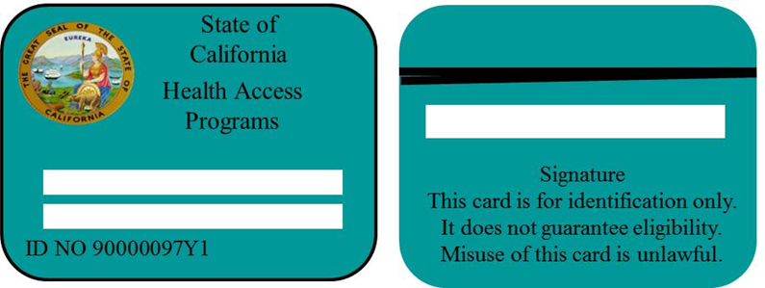
Financial Access to Reproductive Health Care
  Insurance and Funding for CA Residents
    Private Insurance must cover ALL FDA-approved birth control methods without copays
    Family Pact covers contraception and STI testing for those who qualify with income, lack of insurance, high insurance costs, or privacy concerns on their insurance
    Medi-Cal (LA Care) covers reproductive health services, including contraception, prenatal, and abortion services
    Emergency Medi-Cal covers prenatal and abortion care immediately for people who income qualify, including undocumented immigrants
Notes:
Finances can be barrier to accessing health care. Luckily, in California we have a range of programs that assist in covering costs.
In California, all birth control methods from a provider are FREE through all private insurance and through Medi-Cal public insurance. This is a direct result of the Contraceptive Coverage Equity Act that went into effect in 2015.“
Medi-Cal (also called LA Care) also covers STI testing, treatment, prenatal care, and abortion care.
Emergency Medi-Cal covers prenatal and abortion care for people without insurance who income-qualify, regardless of immigration status or documentation.
Family Pact is a program that covers many reproductive health services for people who do not have insurance or who have confidentiality concerns on their insurance. There are income requirements for receiving Family Pact. It’s available regardless of immigration status. Clinics that offer Family Pact are able to enroll patients and activate the program the same day.
Citation:
³ Contraceptive Coverage Equity Act, SB-1053 (2014).
⁴ Plannedparenthoodorg. 2017. Available at: https://www.plannedparenthood.org/planned-parenthood-northern-california/get-care/payment-options/family-pact-fpact. Accessed November 20, 2017.
⁵ Client Eligibility Enrollment. Familypactorg. 2017. Available at: http://www.familypact.org/Get%20Covered/client-eligibility-enrollment. Accessed November 20, 2017.

Slide 64
Reporting Mistreatment
If a client experiences discrimination or mistreatment in a medical setting, they can consider reporting the experience to:
The complaint line or patient services manager at the clinic, hospital, or company
The funder of the clinic or service-
  LA Care: 1-888-839-9909 24/7 Complaint Hotline
  CA Department of Managed Care: 1-888-466-2219
The board or licensing agency of the provider
The CA ACLU or a legal aide organization
  https://lafla.org/get-help/
Notes:
No one should be mistreated or discriminated against. If a client does experience mistreatment, they can consider reporting the incident or incidents to the applicable agency. Here are a few of the agencies that may be applicable.
Sources:
https://www.lacare.org/member-handbook/reporting-problems#:~:text=You%20should%20always%20contact%20L.A.,Tell%20us%20about%20your%20problem.

Slide 65
Resources
Notes:
Now we’ll discuss some strategies to address the sexual and reproductive health needs of the young people that you work with, looking specifically at agency policies, staff training, and access to care issues.

Slide 66
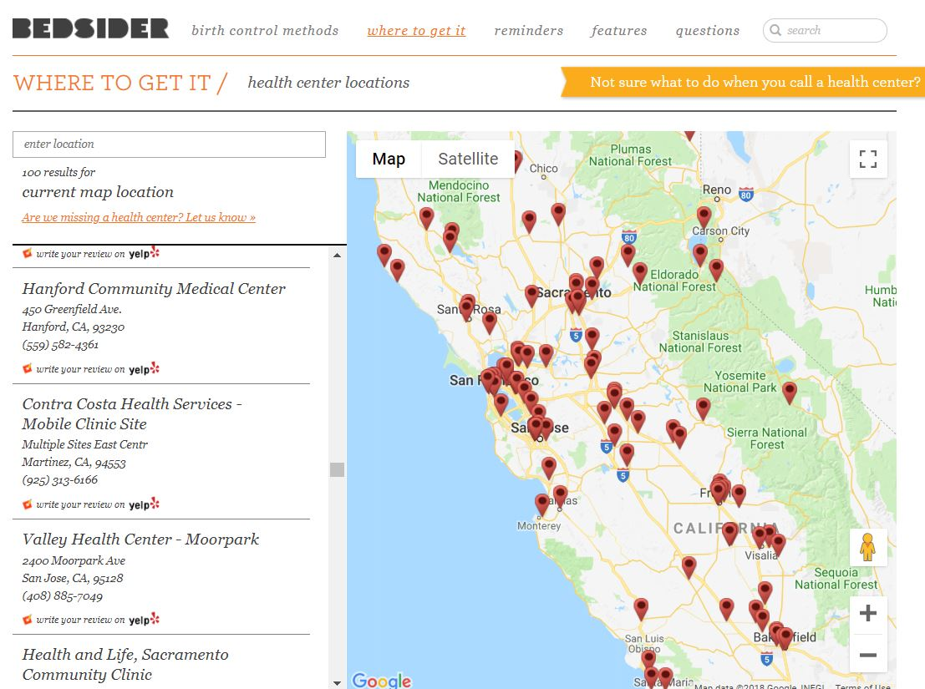
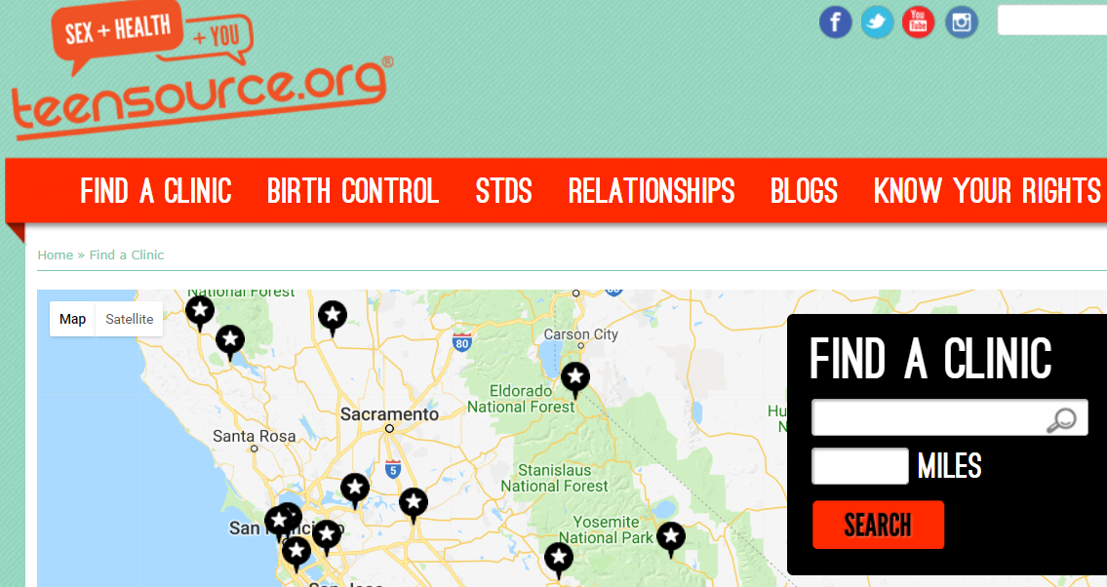
Birth Control Clinic Finders
Notes:
Bedsider and Teensource allow you to search for a birth control clinic near you by entering a zipcode.
Bedsider has a national database for locating family planning health sites for all ages.
https://www.bedsider.org/where_to_get_it
And the version at Teen Sources is for finding birth control clinics in California.
https://www.teensource.org/find-a-clinic

Slide 67
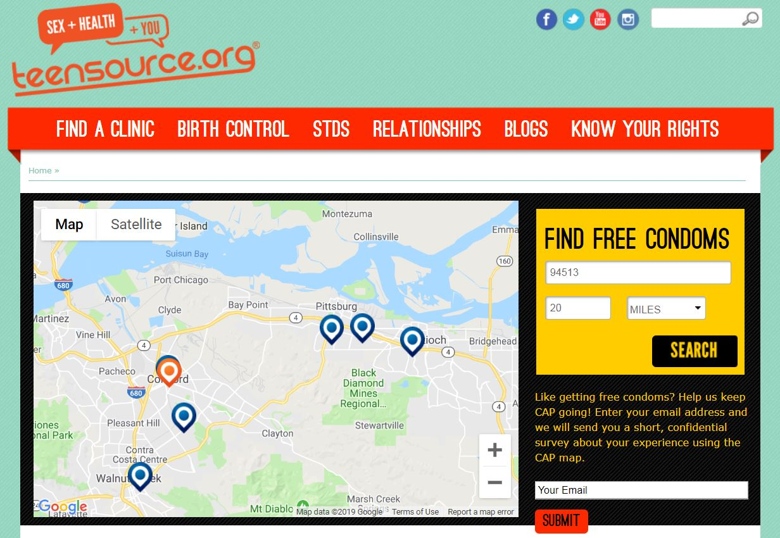
Find Free Condoms - Online
teensource.org/condoms/free/pick-up-map
Notes:
For FREE condoms – you can go to the Teen Source condom finder page. Type in the zip code of where they can go to pick up free condoms anytime they need more.
You may know of other condom finder web and mobile apps – use whichever is most appropriate for the population you are working with. Just make sure the apps still work before you refer people to them.

Slide 68
New Interaction Tool w/ Referrals
Congenital Syphilis in CA – the FACTS!
Pregnancy Intentions Script + Counseling Messages
Integrated Referrals (Syphilis Testing + Reproductive Health Care)
Notes:
Here is a reminder that we are providing this interaction tool that can be used as a hand out or a script

Slide 69
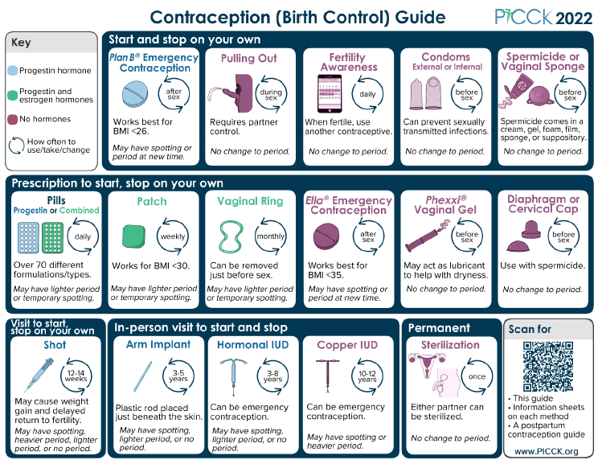
Notes:
The PICCK Birth Control Guide that we covered is available for free in multiple languages at the PICCK website. The site also offers information sheets on each type of birth control, in multiple languages.
Source: https://picck.org/resource/contraception-guide-contraception-information-sheets-and-postpartum-contraception-guide/

Slide 70
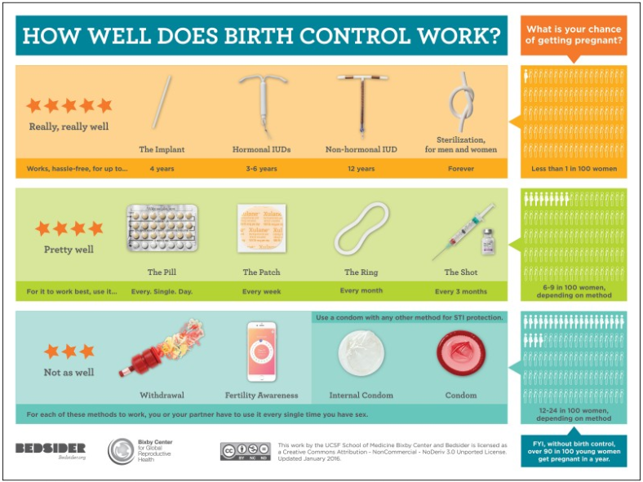
Source: http://beyondthepill.ucsf.edu/tools-materials
Notes:
This birth control overview handout is available from Beyond the Pill as tear off sheets, laminated sheets and posters. It has the most effective methods at the top like the one we reviewed earlier. This, however, does not have all birth control methods. It is missing spermicides, the diaphragm and Lactation Amenorrhea.
The second page covers the 3 types of emergency contraception.
It is available in English and Spanish.
Source: http://beyondthepill.ucsf.edu/tools-materials

Slide 71
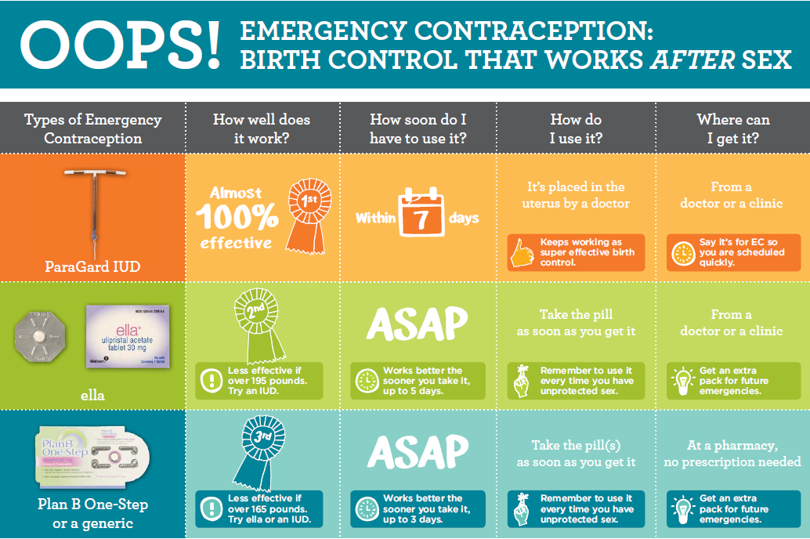
Source: UCSF Beyond the Pill
Notes:
It’s also useful to know about emergency contraception!
Emergency contraception (EC) is the only way to prevent pregnancy after intercourse.
These are 3 the main types of EC and they have varying degrees of effectiveness, in some cases related to how quickly they are used and the weight of the patient.
EC pills are more effective when taken as soon as possible after sex.
People often qualify to get EC for free from a health clinic, and they can even get EC BEFORE they need it. There are also options for purchase over the counter at pharmacies.
Source:

Slide 72
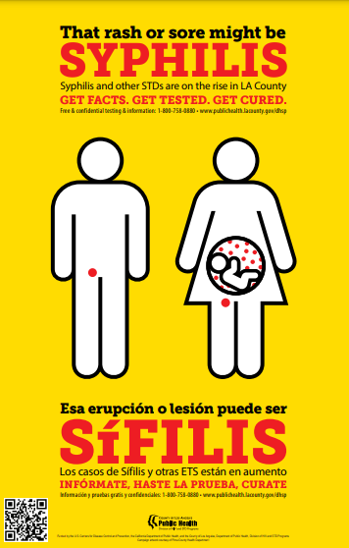
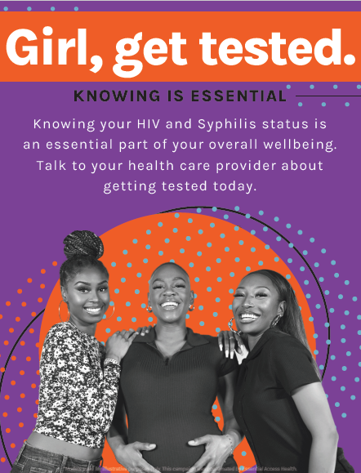
Education Materials
LA County Syphilis in Women Action Toolkit
Notes:
Here are some health education materials to increase awareness of syphilis to your clients
The LA County Department of Public Health’s Syphilis in Women Action Toolkit includes posters and resources for congenital syphilis prevention, testing, and treatment. Access the toolkit via their website, which is hyperlinked on the source for this slide.
Essential Access Health provides “Girl, Get Tested” posters that promote HIV and syphilis testing for African American women. We are continually developing public education materials and would be happy to share materials with your organization.
Source:
http://publichealth.lacounty.gov/dhsp/SyphilisInWomen-ActionKit.htm

Slide 73
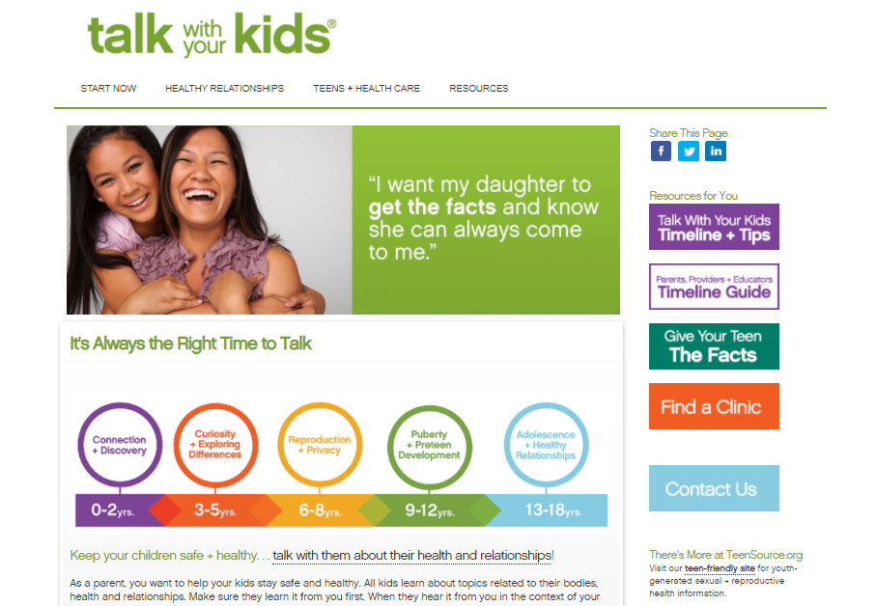
Source: https://www.talkwithyourkids.org/
Notes:
Talk With Your Kids is the adult version of TeenSource- it’s for any adult who has a young person in their life with whom they want to discuss sexual + reproductive health. The Talk With Your Kids timeline provides developmental appropriate discussion topics and activities to help facilitate those conversations.
Find this resource at : https://www.talkwithyourkids.org/

Slide 74

Essential Access Health Learning Portal
Trainings include:
Motivational Interviewing for Quality SRH Care
Immigrant Reproductive Health Access + Rights in California
Preventive Health Care for Transgender + Non-binary Patients
Intro to Reproductive Health (Available in Spanish and English)
https://essentialaccesstraining.org/
Notes:
If you would like to expand your knowledge and skills in reproductive health care, more trainings are available from Essential Access Health through our learning portal. Many are free, some do have a cost associated.
Online trainings and registration are at https://essentialaccesstraining.org/

Slide 75
Resources
CA Department of Public Health website: std.ca.gov
  Data, and resources for health care providers, local health jurisdictions, and the public
LA County Syphilis in Women Action Tool Kit: http://publichealth.lacounty.gov/dhsp/SyphilisInWomen-ActionKit.htm Resources for providers and patients
CA Prevention Training Center: californiaptc.com/
  Trainings, capacity building and clinical consultation
Centers for Disease Control & Prevention: cdc.gov/std
  Fact sheets, treatment guidelines, and national data
Essential Access Health: essentialaccesstraining.org
  Online + In-Person SRH trainings for providers
Notes:
Here are additional websites for data, resources and training.
The California Department of Public Health STD Control Branch – best source for state and local data and tons of resources – including a section that focuses solely on Congenital Syphilis
https://www.cdph.ca.gov/Programs/CID/DCDC/Pages/std.aspx
LA County Syphilis in Women Action Tool Kit:
http://publichealth.lacounty.gov/dhsp/SyphilisInWomen-ActionKit.htm
Resources for providers and patients
The California Prevention Training Center – offers many clinical trainings on STDs plus technical assistance for health care organizations.
https://californiaptc.com/
The Centers for Disease Control and Prevention – a great place for the latest national STD data and STD treatment guidelines.
https://www.cdc.gov/std/
And Essential Access Health’s sexual and reproductive health care training portal. I highly recommend our most popular signature training called Family Planning Health Worker Certification. It’s an interactive and fun 2 day in-person training that will make you more of an expert on all things birth control.
https://essentialaccesstraining.org/ets/home

Slide 76
Thank You!
Katie Farro, STI Prevention Specialist
kfarro@essentialaccess.org
Notes:
We hope the information, resources and tools provided will be helpful to you in your work.
Thank you for listening. We wish much success as you work on eliminating congenital syphilis.

