Slide 1
Cesarean Section and VBAC – Risks, Benefits, Complications, Care of the Birthing Person and Infant
Presented by Carmen Rezak, MJ, MSN, RN, WHCNP-BC
Executive Director Perinatal Quality Improvement/RPPC Manager
South Coastal/East Los Angeles
Perinatal Advisory Council (PAC/LAC)
August 16, 2023

Slide 2
I have no conflicts to disclose.

Slide 3
OBJECTIVES
Provide overview on Cesarean Section and Vaginal Birth After Cesarean (VBAC)
Discuss risks, benefits, side effects, complications, alternatives, for birthing persons and neonates
Discuss postpartum assessment and care
Provide warning and danger signs
Discuss Follow-up care with health care provider

Slide 4
What is a Cesarean section aka C-section or Cesarean Birth
Surgical delivery of one or > babies through an incision in the birthing person’s abdomen and uterus often performed for a medical indication.
WHO recommends that C-sections be performed only when there is a medical necessity
California Quality Care Collaborative (CMQCC) promotes vaginal births and reducing primary cesarean sections for first pregnancy low-risk, Nulliparous-Term-Singleton-Vertex cesareans.

Slide 5
Medical Indications for C-section
Mutliple gestation
Labor not progressing
Breech or other unstable lie such as transverse or oblique
Shoulder dystocia - macrosomia
Problems with the placenta or umbilical cord
History of previous section with a vertical scar
Severe preeclampsia/eclampsia
Emergency/stat C-section infant’s health in danger – Fetal Distress/Category III
Other chronic medical conditions

Slide 6
Non-Medical Indications Birthing Person’s Choice
Some birthing persons and in some cultures prefer to have a scheduled C-section even though there is no medical indication and vaginal delivery is recommended or an option
It is important for the health care provider to discuss all options and promote shared decision making
Informed Consent by the physician
Regardless of choice of delivery unless there is a medical indication no delivery should occur before 39 weeks gestation for the most developed infant brain (MOD)

Slide 7
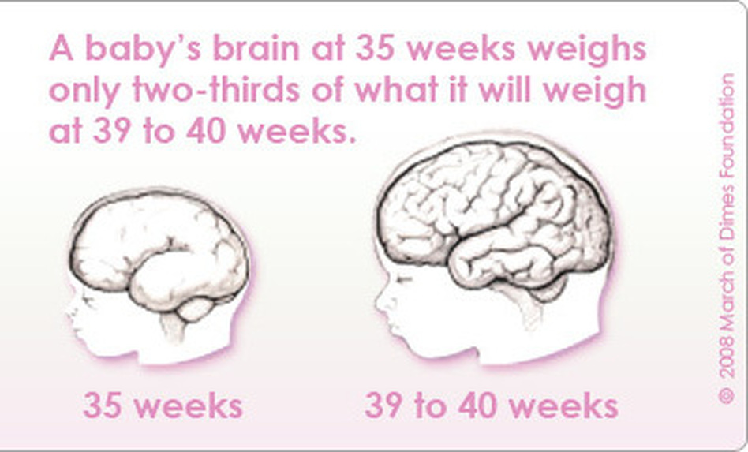

Slide 8
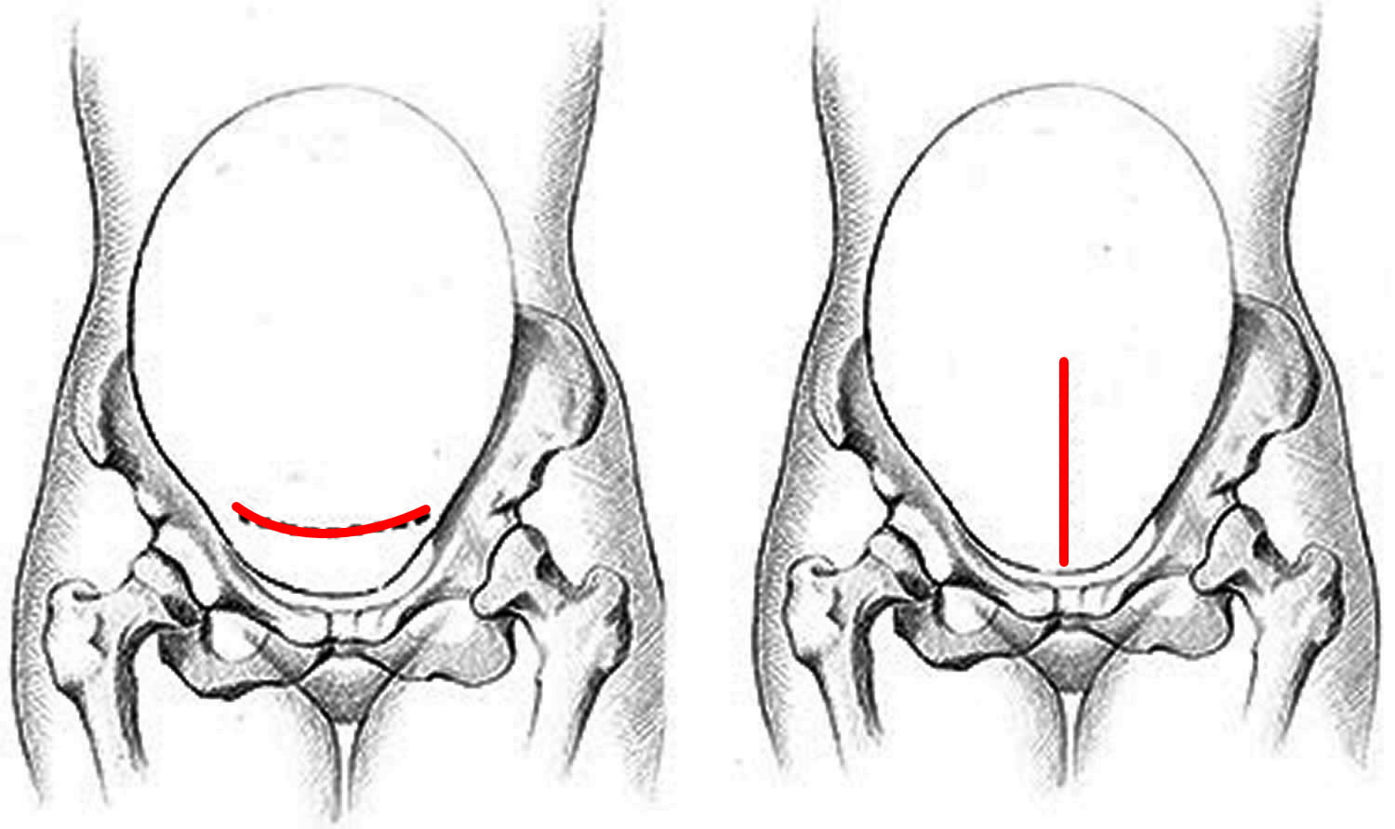

Slide 9
Differences between Vertical and Horizonal Incisions
Horizonal/transverse is the predominant incision – takes longer to access, sometimes called the “bikini” incision, more bloody; more able to have a TOL and VBAC
Vertical incision – more rapid access to uterus, used in an emergency
Uterine rupture if try have a vaginal del; contraindicated for trial of labor (TOL); takes longer to heal, less cosmetically appealing

Slide 10
Advantages of a C-section
Can be scheduled for convenience and decide when to give birth for both the birthing person and physician
Do not experience the pain of labor – great fear for some persons
Can reduce anxiety of waiting for labor to start
Decrease the risk of incontinence and sexual dysfunction
Decrease trauma to the infant not going through the birth canal

Slide 11
The Unintended Consequences of Cesarean Birth Cesarean birth creates more risk for most low-risk birthing people, including the risk of hemorrhage, uterine rupture, abnormal placentation, and cardiac events.
Because the rate of vaginal birth after cesarean (VBAC) remains below 15% in the United States, the biggest risk of the first cesarean may very well be the likelihood of subsequent cesareans.
The risk of uterine rupture, uterine atony, placenta previa, placenta accreta, and surgical adhesions increase with each cesarean.
By the third cesarean, the risk of placenta previa nearly triples, and roughly 40% of people with placenta previa will also have placenta accreta.
Psychological stress, anxiety, and post-traumatic stress disorder (PTSD) have been identified as risks of cesarean.
Patients also experience less acute but significant consequences: longer hospital stays, increased pain and fatigue, and slower return to normal activities
CMQCC (2022). Promoting vaginal birth Toolkit.

Slide 12
Possible Maternal Risks from C-section
Infection
Blood loss/hemorrhage
Embolism - Blood clots in legs, pelvic organs, lungs (life threatening
Injury to surrounding structures, i.e. bowel or bladder
Incision might weaken uterine wall
Reaction to medication or anesthesia, especially general

Slide 13
More Maternal Risks
Abnormalities of placenta in subsequent pregnancies
Increased risk of complications like placenta previa, placenta accreta, placenta increta, placenta percreta
Uterine rupture – uterus tearing along the scar line if attempting a vaginal delivery in a later pregnancy
ACOG – choice of c/section is not a good choice for first pregnancy if a woman is planning to have several children;
> c/sections > risks with future pregnancies
> 90% risk for repeat C/section with future pregnancies after 1st

Slide 14
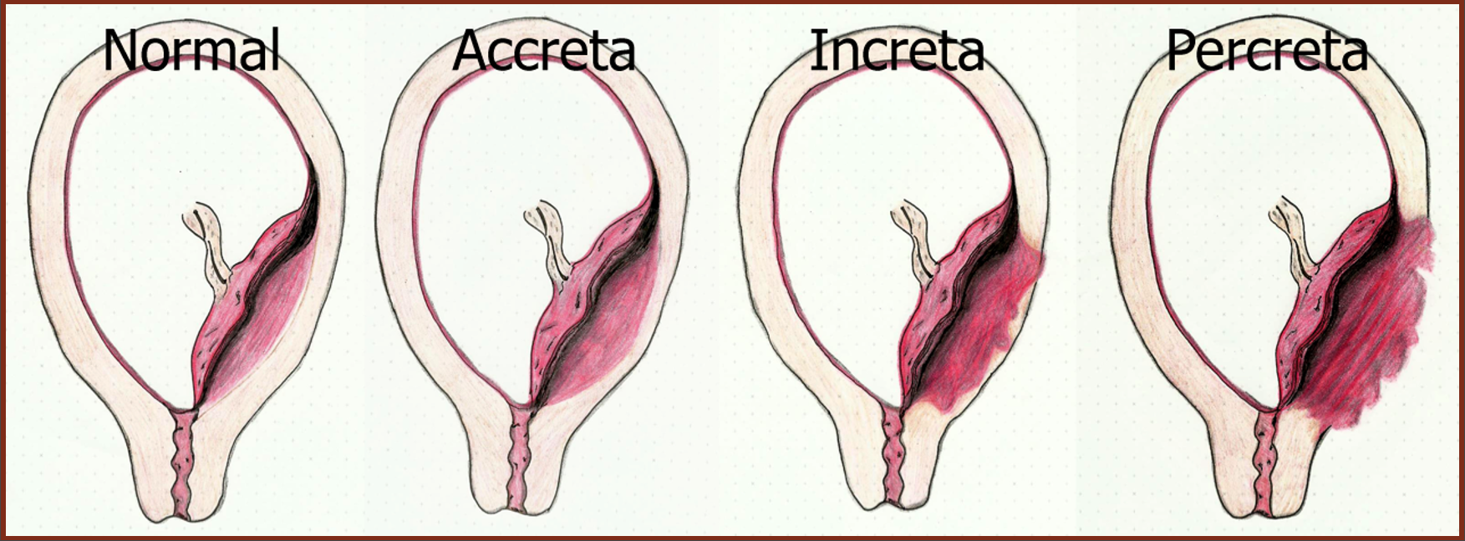

Slide 15
Risks to the Infant
Risks of cesarean birth for neonates are equally concerning. Apart from fetuses in breech presentation, neonates have reaped few benefits from the rising cesarean birth rate
As cesarean rates increased in recent decades, cerebral palsy rates remained unchanged
Evidence also indicates that significant health consequences, including higher rates of serious respiratory complications
cesarean birth remains a barrier to early breastfeeding support, delays the first feeding, and may interfere with early skin-to-skin contact
Respiratory problems – transient tachypnea – difficulty clearing fetal lung fluid
Pulmonary hypertension increases
Surgical injury – accidental nicks to the skin can occur
Increased NICU admissions

Slide 16
Disadvantages
> 90% chance of repeat c/section
Longer hospitalization
Longer recovery
More discomfort – pain meds
Higher complications rates – bleeding, infection
Increased risk to the infant – more admissions to NICU

Slide 17
Postpartum Care and Assessment
Plenty of rest
Nutrition – about 300 more calories especially if breastfeeding
No lifting > 25 pounds
Pain relief – Ibuprofen or Acetaminophen; opioids
Pelvic rest – nothing in vagina for 6 weeks
No driving for about 1-2 weeks, especially wait if taking opioids for pain
Breastfeeding on demand - > 8 times and at least once during the night
Formula feeding – paced bottle feeding;
F/U with health care provider at 6 weeks, 1 week post op if need to remove staples, 72 hours if had severe preeclampsia or other hypertension issues, hemorrhage or other serious complications; 1-2 weeks if health concerns
Recommend support group for lactation – socialization, advocacy
Father support group

Slide 18
Perinatal Mood Anxiety Depression (PMADS)
Important to assess for blue, depression, anxiety,
Baby Blues first two weeks – normal – emotional, change in hormones, fatigue, adjustment to new roles
Depression after two weeks – loss of appetite, mood swings, lack of joy in life, not engaged, lack of bonding with infant, decreased breast/chest feeding
If symptoms don’t go away, have trouble caring for baby, completing daily tasks, decreased hygiene, thoughts of harming self or baby
ACOG recommends postpartum care be ongoing – contact health care provider within 3 weeks post delivery; ensure postpartum eval by 12 weeks at the latest

Slide 19
Postpartum Visit Assessment
Adjustment to motherhood; promoting family attachment; stress
Bonding
Coping skills
Breasts – engorgement, cracked nipples, sore, bleeding
Breastfeeding/Chest feeding; lactation support
Father’s involvement
Incision assessment – intact, redness, swelling, leaking, pus, foul odor, discharge
Abdomen – distension, passing gas, bowel sounds
Fever
Lochia – pink-brown 2-6 weeks; Heavy bleeding, passing clots
Pain assessment
Nutrition
Bowel/Bladder - Voiding and bowel movement, last BM, constipation
Sleep/fatigue
PMADS
Inspect lower extremities - assessment for clots, embolism – color, calf size bilateral, tenderness, warm to touch, pedal pulses, reflexes DTRs

Slide 20
More Post-op C-section Assessment
SDOH – environment, safety, in and outside the home, IPV or any violence; hygiene, cleanliness of home, food security, understanding self-care, infant care, F/u mother and pediatric appointments
Understanding Danger signs for mother and infant; family members to be educated and participate in care
Support in the home – any assistance
Assess for any substance use
Infant – feeding, safety, safe sleep, SIDS/SUIDS
WHO recommends assessment at 3 days, 1-2 weeks, 6 weeks, 10days to 2 weeks for baby blues

Slide 21
Sexuality and Contraception
Important to engage in conversation
Future birth plans
Birth spacing
History of contraceptive use
Options – Depo provera, OCP – wait 3-6 weeks for combined pill to avoid risk of blood clots after c/section, condoms, vaginal ring, IUD immediately up until 48 hours after birth or 4-6 weeks after birth

Slide 22
Danger Signs Post op/Postpartum
Signs of infection:
Red or swollen incision - pus or leaking discharge from the incision – foul smelling odor - Fever >100.4 F - worsening pain, tender abdomen
Other signs of a problem include heavy bleeding > 1pad/hour
or severe, worsening pelvic pain and cramping
Shortness of breath, chest pain
Pain in calf, redness, swelling
Head aches that won’t go away; blurred vision

Slide 23
Pregnancy Loss – Neonatal Death
Ensure F/U with health care provider
Emotional support
Bereavement counseling
Support group
Counseling on recurrent risk and future family planning

Slide 24
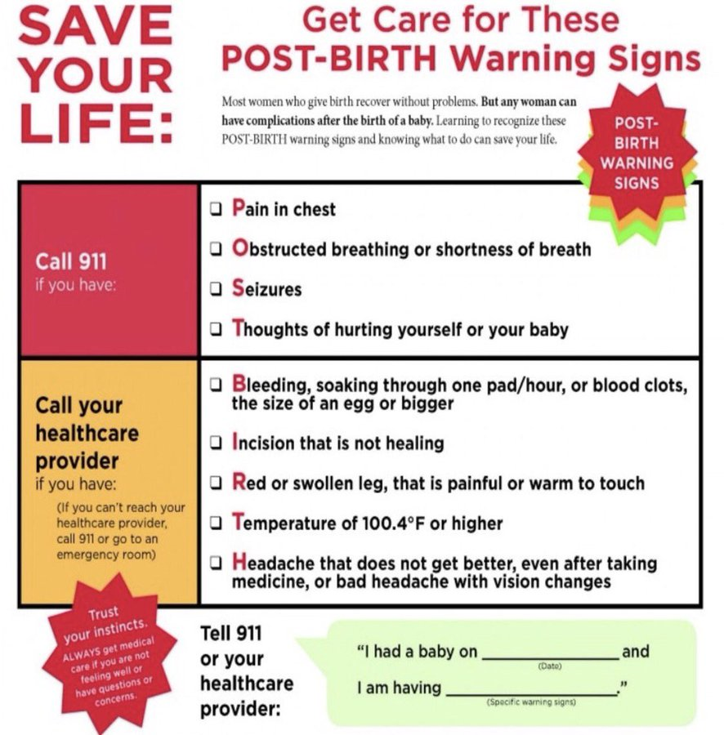

Slide 25
Postpartum Health Equity
Focus on women of color and indigent as to maternal warning signs and symptoms
Postpartum or the 4th trimester considered up to one year post delivery
Black women have 3-4X risk for maternal mortality and preterm delivery
Presentation to the ED post partum not listened to or relate to perinatal situation – especially missed Severe preeclampsia, PE, cardiomegaly
HEAR Her campaign from CDC.gov

Slide 26
Vaginal Birth After C-section (VBAC)
Vaginal delivery of a baby after a previous pregnancy delivery by C-section
Trial of labor after cesarean (TOLAC)
NICHD research shows among appropriate candidates, about 60-75% of VBAC attempts are successful
KEY – choosing appropriate candidates, experience of provider, Maternal Level of Care facility that can accommodate VBAC
VBAC reasonable option for many women

Slide 27
When is VBAC Appropriate?
Prior C-section incision was low transverse (incision on uterus is different than incision on the skin)
Women who have had no more than two previous low-transverse Cesarean incisions
Women younger than 35 years fewer complications and more successful
Better chances if you go into labor on your own; uterine rupture increases with induction
Calculators help with decision making for a VBAC – help predict chances of a successful VBAC – not 100% accurate
ACOG (2017). Practice Bulletin No. 115, Vaginal birth after previous cesarean delivery. OB/GYN, 116(2), 450-463.

Slide 28
Benefits of VBAC
No abdominal surgery
Lower risk of hemorrhage and infection
Faster recovery
Potential to avoid risks of c/section delivery such as hysterectomy, bladder injury, blood transfusion, infection

Slide 29
Who is Not a Candidate for VBAC
Previous vertical or “classical” incision or T-shaped incision
Labor dystocia – slow or difficult labor
Multiple C-sections – change of successful VBAC decreases with multiple C-sections
Baby is breech
Chronic diseases such as heart or lung increase risks
Having a large baby especially over 10#
Going beyond due date – past 40 weeks
Obesity

Slide 30
Risks of VBAC
Uterine rupture is the main risk – tear in the wall of the uterus; rupture of C-section scar
Often occurs at the site of the previous C-section
It is potentially dangerous but rare - < 1%
As a result of a uterine rupture consequences to the mother – blood transfusions, hysterectomy to control the bleeding
Risks to the baby – serious injury or death caused by decreased blood flow to the baby
Very important for women to speak to her physician early in the pregnancy to discuss risks, benefits and likelihood of successful VBAC

Slide 31
If TOLAC Fails
If labor fails to progress or other issues, may need a C-section after trying TOLAC
Most risks association with C-section after TOLAC are similar to those association with a repeat C-section:
Uterine rupture
Hemorrhage and infection
Blood clots
Need for a hysterectomy

Slide 32
Why Some Physicians and Hospitals Don’t Perform VBACs
VBACs declined in the early 2000’s
Become pregnant 6 months or less after a C-section; best to wait
Lack of 24 - hour anesthesia
Ob in-house or readily available on-call to respond of need for C-section
Higher liability – malpractice; potential for lawsuits
Some physicians are not equipped to handle an emergency C-section
Some physicians are more conservative in their labor practice
Some hospitals fear they don’t have the right facilities in case of uterine rupture
Faster and easier for a provider to schedule a C-section than to wait for patient’s labor to progress naturally

Slide 33
Postpartum Assessment and Care
Recovery is similar to a normal vaginal delivery
The same assessment is performed after a VBAC
Bleeding and spotting
Avoid heavy lifting
Rest
Nutrition

Slide 34
Thank you! Contact Information crezak@paclac.org 626.806.6674

