Slide 1
Nurturing Families to Create Safe Environments for Infants and Young Children February 15, 2023
Presented by Carmen Rezak, MJ, MSN, RN, WHCNP-BC
Executive Director Perinatal Quality Improvement
Regional Perinatal Programs California (RPPC) Manager Southern Coastal/East Los Angeles
Perinatal Advisory Council/ Leadership, Advocacy, Consultation (PAC/LAC)

Slide 2
I have no financial disclosures.

Slide 3
OBJECTIVES
Able to define Sudden Infant Death Syndrome (SIDS), Sudden Unexpected Infant Death Syndrome (SUIDS) and What do we mean by safe sleep?
Describe risk factors for sleep-related deaths and SIDS, SUIDS.
What are the strategies to reduce the risk of sleep-related deaths?
Identify how to create a safe sleep environment for infants and young children.
Describe how to assess for safe spaces during a home visit and a virtual visit.
Promote human milk feeding to decrease risk of SIDS
Discuss impact of mother’s use of substances that increase risk for SIDS
Incorporate cultural awareness/sensitivity with families of diverse ethnic/racial backgrounds to decrease health disparity and implicit bias

Slide 4
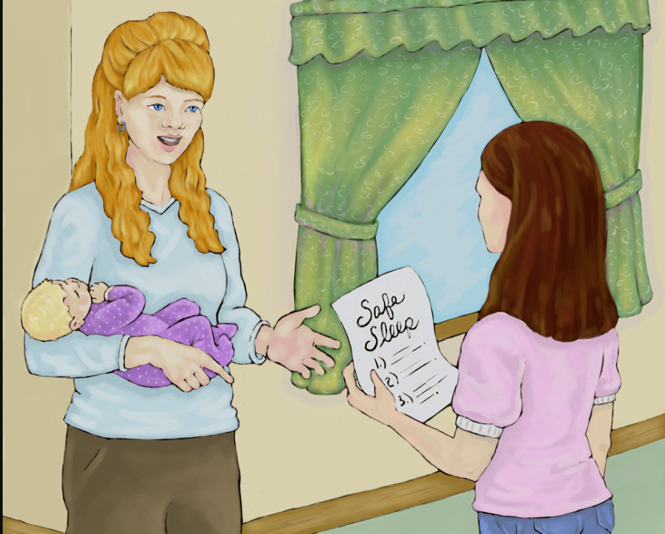

Slide 5
CDPH Letter to California Hospitals and Licensed Midwives 10/19/2020
Subject: Providing sudden unexpected infant death (SUIDS) and Sudden Infant Death Syndrome (SIDS) Risk Reduction Information to Parents or Guardians of NB
Ref: California Health & Safety Code Section 1254.6 (HSC § 1254.6) requires all hospitals in California to provide SUID & SIDS risk reduction information to all parents or guardians of newborns
CDPH/MCAH Division and the CA SIDS Advisory Council consistent with AAP Policy SIDS & other sleep-related infant deaths: Updated 2016 Recommendations for a Safe Infant Sleeping Environment AND Infant Safe Sleep Strategies
Helps families understand the recommendations and address the need to increase cultural competency among providers to better serve ALL families in CA

Slide 6
What is SUIDS?
Any sudden and unexpected death, whether explained or unexplained occurring during infancy
After case investigation, it may be determined that the cause of death was by a specific unnatural or natural etiology such as suffocation, mechanical asphyxia entrapment, infections, ingestions, metabolic diseases, arrhythmia-associated cardiac channelopathies or trauma unintentional or nonaccidental) Moon, Carlin & Hand (2022). Recommendations for Reducing Infant Deaths in Sleep

Slide 7
What is SIDS?
A subcategory of SUIDS and is a cause assigned to Sudden Infant deaths – that doesn’t have a known cause or cannot be explained - even after a full investigation, including at the scene, autopsy and review of clinical history of a baby between 1 month and 1 year of age
About 50% of these deaths that occur in the U.S. are from SIDS
It is the leading cause of death among babies 1 month – 1 year of age
Most SIDS deaths happen when babies are between 1 and 4 months of age
- NIH Safe to Sleep, U.S. HHS (2017)

Slide 8
Other Sleep-Related Deaths
Suffocation –pillow, covers, toys that block baby’s face and nose and unable to breathe
Entrapment – baby gets trapped between two objects such as a mattress and a wall and can’t breathe
Strangulation – when something presses on or wraps around the baby’s neck blocking baby’s airway

Slide 9
Safe Sleep Myth vs. Fact
Babies can “catch’ SIDS
Cribs cause “crib death”
Babies who sleep on their backs will choke if they spit up or vomit during sleep
SIDS can be prevented
Shots, vaccines, immunizations, and medicines cause SIDS
SIDS can occur in babies at any age
If parents sleep with their babies in the same bed, they will hear any problems and be able to prevent them from happening
If a baby product is in a store it is safe for the parents to buy

Slide 10
What is Considered a Safe-Sleep Environment
As a healthcare provider instruct the parents, guardian, person responsible to:
BACK TO SLEEP FOR EVERY SLEEP - Place baby on his/her back for all sleep times-naps and at night
Use a firm, flat, non-inclined sleep surface, such as a mattress in a safety-approved crib, covered only by a fitted sheet
Rooming –in (crib/bassinet) but NO bed-sharing, ideally until your baby is 6 months old
Keep soft bedding such as blankets, pillows, bumper pads, and soft toys out of the baby’s sleep area; no loose bedding
Ensure the baby’s head is not covered or allow the baby to get too hot; no hats; use sleeper sack instead of loose blankets
Offering a pacifier at naptime and at bedtime – adhere to breastfeeding recommendations after 3-4 weeks
No surface sharing – bed couch, chair, or any other surface

Slide 11
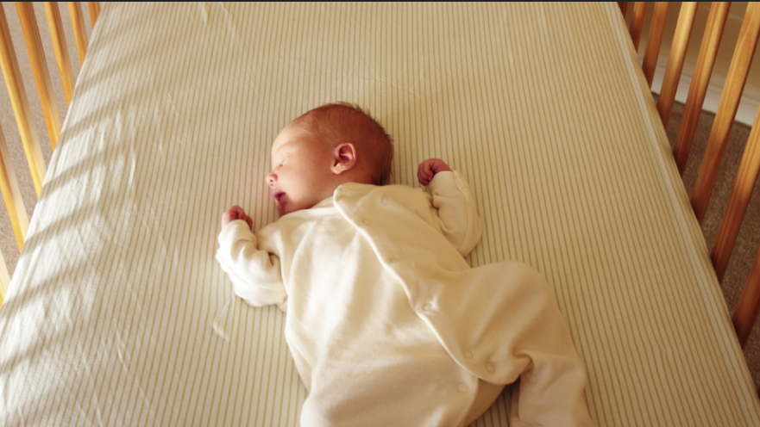

Slide 12
Sleep-Related Deaths – Triple-Risk Model
Encompasses SUIDS, SIDS, Accidental Deaths
Pathophysiology is multifactorial and complex
Triple-risk model is most widely accepted conceptual framework that proposes: 1. SIDS occurs when an infant with intrinsic (natural/essential nature) vulnerability (often manifested by impaired arousal, cardiorespiratory and or autonomic responses) undergoes an exogenous (external) trigger event e.g. an exposure to an unsafe sleeping environment, during a critical developmental period
Because of the multifactorial nature of many sleep-related deaths it can make identification of a single cause of death challenging
- AAP Policy Statement on Sleep-related deaths, revised 2022

Slide 13
Data on Sleep-Related Deaths
Each year in the U.S., about 3,500 infants die of sleep-related deaths
However, we have made great progress since the 1990’s when the back-sleeping recommendations were first released rate dropped by about 60%
BUT, deaths from other sleep related causes have increased and certain groups remain at higher risk for SIDS than others
African America and American Indian/Alaska Native babies are at higher risk for SIDS than White, Hispanic, or Asian/Pacific Islander babies

Slide 15
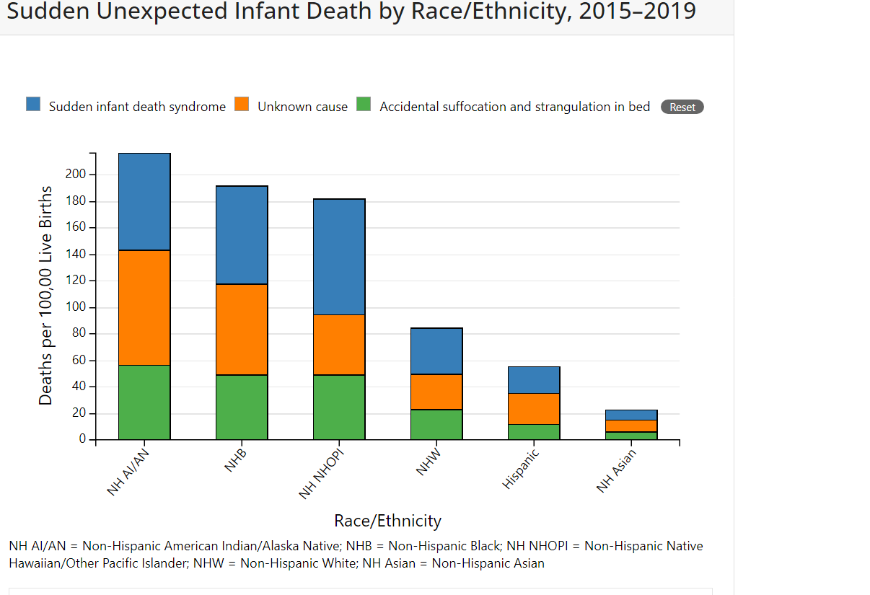

Slide 16
HEALTH DISPARITIES & AI/AN COMMUNITIES
• American Indian/Alaska Native women are more than twice as likely to die from pregnancy-related causes than white women
• American Indian/Alaska Native infants die at nearly twice the rate of white babies
• American Indian/Alaska Native mothers were almost three times as likely to receive late or no prenatal care as compared to white mothers
These statistics contribute to the gap in healthcare disparity and impact neonatal mortality and morbidity
Kozhimannil, K. B. (2020). JAMA Health Forum, Ref: NICHQ

Slide 17
Persistent Racial/Ethnic Disparities
Sleep-related deaths like other causes of infant mortality have notable and persistent racial and ethnic disparities reflecting broader societal inequities
Factors that result in the marginalization of infants and their families, including low socioeconomic status or unemployment, housing instability, domestic violence, food insecurity, unsafe environment are highly correlated with race/ethnicity in the U.S., and are also associated with both higher risks of sleep-related deaths and increased prevalence of known risk factors for these deaths – SDOH
It is important to be aware of these SDOH and to provide trauma-informed care

Slide 18
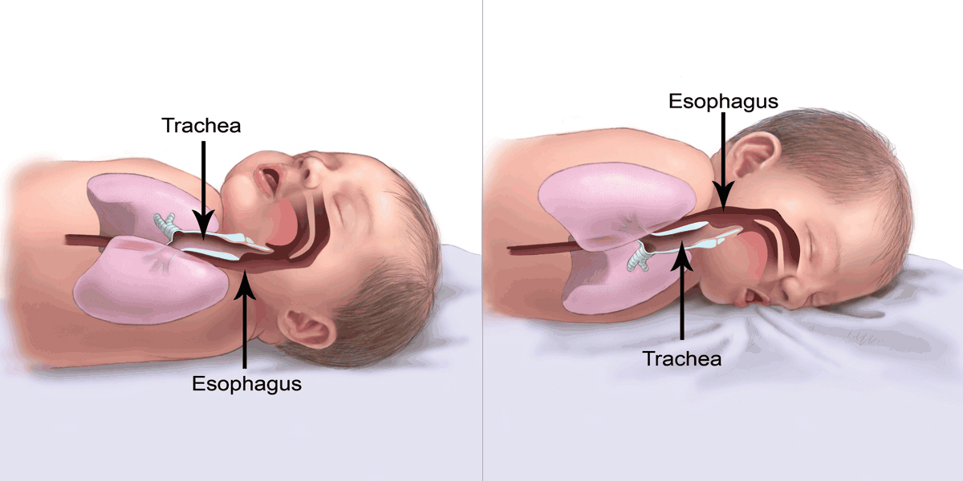

Slide 19
The Importance of Explaining Back Sleeping
Parents and sometimes healthcare professionals believe that infants will choke more if the baby is on its back. It is important to model the correct position.
Often times I see infants propped on their side, the bassinet elevated, or blankets placed over the bassinet
Teach parents that back sleeping will not cause the baby to choke – it protects them from choking
Infants may be better able to clear fluids when they are on their back, possibly because of anatomy
When an infant is in the back-sleeping position, the trachea lies on top of the esophagus, so the airway is more protected. Anything regurgitated or refluxed from the esophagus must work against gravity to be aspirated into the trachea
When an infant is in the stomach-sleeping position, anything regurgitated or refluxed will pool at the opening of the trachea, making it easier for the infant to aspirate or choke.

Slide 20
PRE-TERM INFANTS
< 37 weeks at higher risk for SIDS
Placing on their backs is critical
Exception – preterm infants who have active respiratory disease or upper airway malformation i.e. Robin syndrome may have improved oxygenation if placed on their stomachs and are monitored when doing so
Once respirator status is stabilized, AAP recommends back to sleep

Slide 21
Importance and Promotion of Human Milk
Provide human milk to reduce the risk of SIDS – breast/chest feeding or alternative with spoon, syringe, cup, bottle and nipple
Breastmilk offers a protective role – Infants immune system is immature and breast milk helps to provide necessary antibodies to fight infections such as RSV which can contribute to inflammation of lungs and lead to SIDS
Fights against GI infections as well, better tolerated/digested
Because mothers can make new antibodies better and more quickly, especially when the infant is < 6 months of age, mothers updates her infant’s immunity with every feeding
Especially for premature infants human milk contains substances such as cholesterol, linoleic acid and taurine that enhance the development of the central nervous system and provides vital fats e.g. DHA for myelin the insulating sheath around the nerves that helps impulses travel faster

Slide 22
More on the Importance of Human Milk
Breastfeeding keeps airways open by not exposing the to allergens in artificial milk – e.g. stuffy noses and airways and recurrent respiratory tract infections are frequent signs of allergies to artificial milk (formula)
Breastfeeding helps breathing by:
1. helping the brain’s systems that control breathing to mature and keep tiny air passages
open
2. breastfeeding infants have higher blood levels of progesterone that stimulates breathing
Breastfeeding reduces gastroesophageal reflux or (GER) probably due to huma milk emptying faster from the stomach and has been implicated in life threatening events therefore could help in reducing SIDS
Breastfeeding has a calming effect on a baby and impacts the sleep/wake cycles probably as a result of cue-based feeding (mom responding to her infant’s feeding needs) and the sensitivity between mom and her baby – their harmony
Babies who breastfeed do so more frequently and get more practice coordinating their swallowing and breathing; Preterm infants have narrower breathing passages and weaker muscle support so exercising their coordination and muscles is helpful in keeping airways open

Slide 23
Attachment & Infant Behavior
Compelling new research shows that the strength of mother’s emotional bond with her baby may will trump all of those measures she takes to help her baby thrive
A close attachment can prevent diseases, boost immunity, and enhance IQ in the baby
Children grow and thrive in the context of close and dependable relationships that provide love and nurturance, security, responsive, interaction, and encouragement for exploration
Breast/Chest feeding is one of the best ways to promote bonding
The mother-child bond assures infant survival in terms of protection, nutrition and care – father’s too!
- Francesca D’Amato, MD Behavioral Neurologist

Slide 24
Staff, with appropriate training, should be the
mother’s cheerleader and enthusiastic supporter
for the mother’s plan to provide her milk and
continue to offer her exclusive milk to at least
6 months and when adding complementary foods continue to one year (unless contraindicated)
Pacifiers are encouraged for naps and nighttime sleep, after breastfeeding is established after 3-4 weeks post birth.
Instruct parents - never hang a pacifier around the infant’s neck or attach it to infant clothing when placed for sleep or sleeping – risk of strangulation
- AAP recommendation & Safe Sleep Guidelines, (revised 2022)

Slide 25
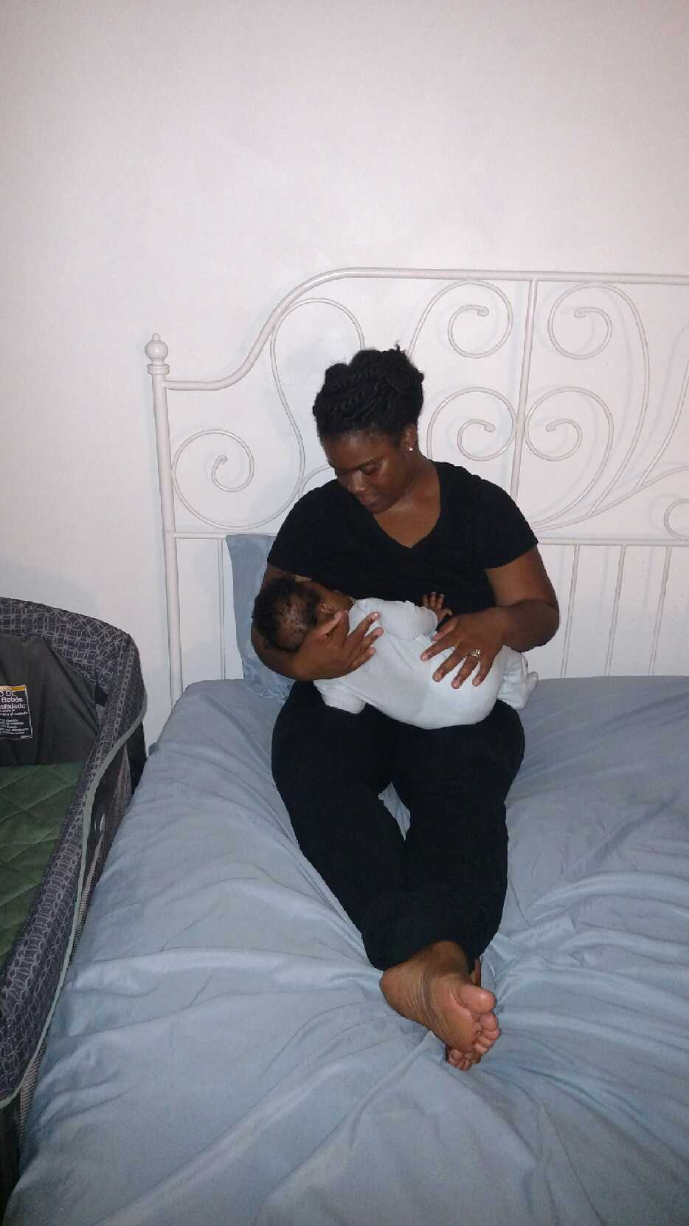

Slide 26
Bed Sharing/Co-Sleeping/Room Sharing
NO bed sharing – increases risk of accidental suffocation and other sleep-related causes of infant death – this necessitates a respectful conversation especially when working with families from another culture that has the mom and infant together at all times
Mother’s or fathers may roll-over on their infant’s while sleeping; no bed sharing with someone who is not the infant’s parent is discouraged
NO co-sleeping. When breastfeeding can be together for a short term as long as the mother is not sleepy and awake
Room-sharing is ok and can have the crib or bassinet right next to the parents bed; multiples placed in their own crib or bassinet
The AAP understands and respects that many parents choose to routinely bed share - cultural practices, breastfeeding and a belief that it is better and safer, but based on the evidence it is not recommended under any circumstances
No soft surfaces – watered, couch, sofa, armchair – 5-10 times the baseline risk
Do not use home heat or breathing monitors to reduce risk of SIDS

Slide 27
Swaddling
There is no recommendation to decrease SIDS
When done correctly it can ben an effective technique to help calm infants and promote sleep (AAP, 2022)
Studies have found that incorrect swaddling can cause hip and shoulder dysplasia, head covering and strangulation
When an infant exhibits sigs of attempting to roll (around 3-4 months or earlier) swaddling is no longer appropriate because it could increase the risk of suffocation
Instruct parents and caregivers to use caution
AAP Swaddling Guidelines – http://www.healthychildren.org/swaddling - is-it-safe.aspx

Slide 28
Tummy Time
When baby is awake it is encouraged to have tummy time though the AAP has no specific recommendations on how often or how long
Someone needs to be watching at all times – observe the infant
Supervised tummy tie helps the baby’s neck, shoulder and arm muscles get stronger
Helps prevent flat spots on the back of baby’s head
Holding baby upright and limiting time in carriers and bouncers can also help prevent flat spots

Slide 29
Substance Use and the Increased Risk SIDS
Bedsharing with anyone who is impaired in their alertness or ability to arouse because of fatigue, use of sedating medications, certain antidepressants, pain medications or substances such as alcohol, illicit drugs is never allowed
A smoke-filled environment is unsafe and increases the risk of SIDS; it is the #1 risk; avoid smoke and nicotine exposure
Avoid alcohol, marijuana, opioids, and illicit drug use
The risk of SIDS is significantly higher with concomitant smoking and alcohol use
Substance use with bed sharing places the ifant at particularly high risk for SIDS and suffocation

Slide 30
Scarlet Sunshine Act 2021
Focused on SUID and calls for continuing support of CDC’s and the NIH SIDS and SUIDS in the fatality case reporting systems.
Encourages reporting of sleep-related infant deaths and is a systematic way of reporting.

Slide 31
Butyrylcholinesterase (BChE)
Autonomic dysfunction has been implicated in the pathophysiology of SIDS
Potential biomarker for SIDS
Enzyme of the cholinergic system, a major branch of the autonomic system
Australian study to evaluate BChE activity in infants and young children who had died from SIDS or SUIDS
Case-control study measures BChE and total protein taken from dried blood spots take at birth as part of the NB screening program
Results of 67 SUIDS classified by the coroner compared to controls
Findings: Conditional logistics regression showed that in groups where cases were reported s “SIDS death” there was strong evidence that lower BChE specific activity was associated with death whereas in groups with a “non-SIDS death” there was no evidence of a linear association between BChE and death
Harrington, C.T. Hafid, N.A., 7 Waters K.A. (2022). Butyrylcholinesterase is a potential biomarker for SIDS. www.thelancet.com, Vol 80. https://doi.org/10.1016/j.ebiom.2022.104041

Slide 32
Home Safety for Young Children Ages 1-5
Majority of injuries to young children ages five and younger occur in the home and those one year and younger are most vulnerable.
Staff can help prevent injuries by helping families become more aware of the risks to children’s safety and partner with families to reduce injuries that occur on the home during the home visitation
Things to focus on: addressing family safety concerns, educating about safety hazards, completing home safety checks and teaching families how to do these checks, identifying safe practices and providing resources for families to obtain safety devices

Slide 33
Home Safety Cont.
Families need support and resources to eliminate hazards, obtain safety equipment and learn active supervision strategies and injury prevention strategies
Examples replacing batteries in smoke detectors or ensuring there are smoke detectors in the residence, locking up chemicals and cleaning supplies, storing medications out of children’s reach, secure electric socket covers, oven protectors, guardrails, bathtub thermometers, gates for stairs and doorways, lock for cabinets and drawers, assessing for firearms and security, etc.
Ensuring proper child passenger safety seats and use for travel/transportation

Slide 34
Effective Communication and Partnership
Families have different cultural perspectives or expectations of their child’s behavior based on their beliefs and traditions.
Respecting those beliefs ad experiences and values are better able to acknowledge and support parent’s efforts.
Engaging in mutually respectful, goal-oriented partnerships with families allows staff to share injury prevention information and build trusting relationships.
Individualizing each family’s safety needs and concerns in safe well-supervised environments supports all children’s learning and healthy growth and development.
U.S, Department Health & Human Services, Administration for Children & families, National Center on Health. Actions to create a culture of safety (2022). https://eclkc.ohs.hhs.gov/

Slide 35
Recommendations
Research confirms advice from healthcare providers makes a difference I parent and caregiver decisions about sleep positions and environment.
When providing home visits ensure the environment is safe for infants and young children by reviewing safe sleep instructions and assessing for risks with parents/caregivers/guardians and provide resources
Model and emphasize back to sleep and why it is so important
Emphasize smoke-free, drug-free environment as the safest for baby and children and creates the greatest risk for SUIDS/SIDS
Provide resources – low literacy education handouts, web sites and provide in the language that is most spoken in the home

Slide 36
Recommendations continued
Addressing the potential impact of structural racism and recognizing the lack of access to economic, social and educational resources as risk factors and providing thoughtful and respectful conversations about safe sleep will be important in improving understanding of the most effective strategies to promote adoptions of safe infant sleep practices among various populations.
Reinforce the recommendations discussed and work with families of diverse cultures in understanding their norms and how we can together achieve safety for infants and young children.
Respectful communication and sometimes compromise is necessary. Things are not always black and white and understanding cultural norms and individualizing and strategizing with evidence-based practice and recommendations to achieve the best clinical outcome may provide the best win.

Slide 37
References/Resources
https://www.cdc.gov/SIDS/idex.htm
CDC Vital Signs http://www.cdc.gov/VitalSigns/Childinjury/Unforgrapohic.htk?s_cid-bb-vitalsigns-123
National Action Partnership to Promote Safe Sleep. NICHQ
https://eclkc.ohs.acf.hhs.gov/health
https://www.nichq.org/resource/safe-sleep-faq-child-care-providers
http://pediatrics.aappublications.org/content/138/5/e20162938
(NEW: Sleep-Related Infant Deaths: Updated 2022
Recommendations for Reducing Infant Deaths in the Sleep Environment)
https://bmjopen.bmj.com/content/3/5/e002299.info
https://www.aap.org/en-us/about-the-aap/aap-press-room/pages/Despite-Danger-of-SIDS-Only-44-Percent-of-Parents-Always-Put-Baby-to-Bed-on-Back.aspx
https://www1.nichd.nih.gov/sts/campaign/science/Pages/other.aspx
Tappin, D., Mitchell, E. A., Carpenter, J, Hauck, F. & Allan, L. (2021). Bed-sharing is a risk for sudden unexpected death in infancy. BMJ

Slide 38
References/Resources
Safe to Sleep Campaign https://safetosleep.nichd.nih.gov/
American Academy of Pediatrics (AAP) Safe Sleep Recommendations https://www.aap.org/en-0us/advocacy-and-policy/aap-health-initiatives/safe-sleep/Pages/Safe-Sleep-Recommendations.aspx
Center for Disease Control and Prevention (CDC) Safe Sleep Resources https://www.cdc.gov/sids/index.htm
Baby Anatomy – Safe-Sleep https://ct1.medstarhealth.org/content/uploads/sites/10/2017/08/BabyAnatomy-Safe-Sleep.jpg

Slide 39
Thank-you!
Contact information
Carmen Rezak
crezak@paclac.org
818.708.2850

