Slide 1
CONOZCA SUS DERECHOS ULTIMAS NOTICIAS DESPUES DE LA INAUGURACION
Public Counsel

Slide 2
KNOW YOUR RIGHTS Post-INAUGURATION update
Public Counsel

Slide 3
GUIA
Después de la inauguración: lo que sabemos, y lo que no sabemos
Resumen breve de la ley de inmigración
Enfocando en la Visa U, SIJS, y inmigración por familia
Actualización de las ordenes ejecutivas
Quien esta en alto riesgo de la deportación
Conozca Sus Derechos
Que hacer si ICE llega a su casa
Derechos en los procedimientos de deportación
Como hacer un plan de seguridad para su familia
Preguntas?
Notes:
How do these topics sound? Are these the issues that have come up with your clients?

Slide 4
OVERVIEW
Post-inauguration update: what we know, and what we don’t know
Brief overview of immigration law
Esp. U Visa, SIJS, family-based
Executive Orders update
High-risk enforcement categories
Know Your Rights
What to do if ICE shows up at your door
Immigrant rights in deportation proceedings
Make a safety plan
Questions?
Notes:
How do these topics sound? Are these the issues that have come up with your clients?

Slide 5
Public counsel
Public Counsel es un bufete de abogados sin fines de lucro en Los Angeles, California. Proveemos servicios legales sin costo a personas de bajos recursos
Nuestro proyecto de Derechos de los Inmigrantes representa a personas buscando asilo, victimas de los crimines, niños sin acompañamiento, y inmigrantes en detención
Notes:
The Immigrant Rights Project does not do family petitions or general immigration consultations outside of these areas, but we have a list of low-cost consultations to distribute

Slide 6
Post-INAUGURATION update
Que es lo que sabemos?
El Presidente esta poniendo y quiere poner mas reglas anti-inmigrante
Muchos gobiernos locales en California están comprometiéndose a proteger las comunidades inmigrantes
Que es lo que no sabemos?
No sabemos con cuales de las promesas anti-inmigrante de la campana se van a cumplir
No sabemos cuales barreras legales se enfrentarán las nuevas reglas anti-inmigrantes
Notes:
We know the President-elect ran on a campaign platform that included many anti-immigrant proposals, including a ramping up of deportations, the elimination of DACA, and the construction of a border wall between the US and Mexico. So far ALL he has done is 1) promise to build a border wall, 2) reset deportation priorities. He has NOT ended DACA (though he might) and he has NOT ended the refugee program (though he might).
We know that local governments- including both the state of California and the city and county of Los Angeles- are evaluating what steps they can take to protect immigrant communities

Slide 7
Post-INAUGURATION update
What do we know?
The President is enacting and intends to enact anti-immigrant policies
State and local governments in California are committed to protecting immigrant communities
What don’t we know?
We do not know which anti-immigrant campaign promises will be met
We do not know the legal barriers that any new anti-immigrant policies would face in the courts
Notes:
We know the President-elect ran on a campaign platform that included many anti-immigrant proposals, including a ramping up of deportations, the elimination of DACA, and the construction of a border wall between the US and Mexico. So far ALL he has done is 1) promise to build a border wall, 2) reset deportation priorities. He has NOT ended DACA (though he might) and he has NOT ended the refugee program (though he might).
We know that local governments- including both the state of California and the city and county of Los Angeles- are evaluating what steps they can take to protect immigrant communities

Slide 8
RESUMEN BREVE DE LA LEY DE Inmigración
En general, inmigrantes pueden recibir estatus legal a través de:
La familia
Un empleador
Beneficios humanitarios
Formas temporales de estatus incluyen:
DACA
La discreción del fiscal
Status de Protección Temporal (TPS)
Notes:
Family based petitions- spouses, parents, children, & siblings
Employer petitions
Humanitarian benefits
Asylum, withholding, and the Convention Against Torture (CAT)
U- and T- visas; VAWA
Special Immigrant Juvenile Status (SIJS)
Cancellation of removal [ONLY in removal proceedings]
Many MANY complications and roadblocks to these forms of relief- especially for people who have lived in this country without permission for a period of time (and even more so if you entered without inspection- most Mexicans and Central Americans).
Most types of humanitarian relief are also discretionary

Slide 9
(VERY) Brief IMMIGRATION LAW OVERVIEW
In general, immigrants can receive immigration status through:
Family
Employers
Humanitarian benefits
Other forms of temporary relief
DACA
Prosecutorial discretion
Temporary protected status (TPS)
Notes:
Family based petitions- spouses, parents, children, & siblings
Employer petitions
Humanitarian benefits
Asylum, withholding, and the Convention Against Torture (CAT)
U- and T- visas; VAWA
Special Immigrant Juvenile Status (SIJS)
Cancellation of removal [ONLY in removal proceedings]
Many MANY complications and roadblocks to these forms of relief- especially for people who have lived in this country without permission for a period of time (and even more so if you entered without inspection- most Mexicans and Central Americans).
Most types of humanitarian relief are also discretionary

Slide 10
BENEFICIOS DE Inmigración
Si nunca ha consultado con un abogado de inmigración acerca de la posibilidad de aplicar para estatus legal, tal vez ahora es el tiempo de hacerlo, especialmente si
Ha sido victimizado por un crimen reportado en los estados unidos
Tiene marido que es ciudadano o residente permanente o niño mayor de 21 años que es ciudadano o residente permanente
Es menor de 21 años y ha sido abandonado o dañado por un padre
Notes:
These are the most likely forms of immigration relief for people living here without immigration status

Slide 11
IMMIGRATION BENEFITS
If you have never consulted with an immigration attorney about the potential of applying for status, now may be a good time to do so, especially if:
You have been a victim of a reported crime in the United States
You have a USC or LPR spouse or 21+ child
You are under 21 and have been hurt or abandoned by a parent
Notes:
These are the most likely forms of immigration relief for people living here without immigration status

Slide 12
Hable con un abogado
Asegure que busque la ayuda de un abogado, NO de un notario
En los estados unidos, los notarios nunca tienen autorización para ejercer la abogacía
Notarios tampoco pueden aceptar dinero de parte de un abogado
Si antes un notario le engaño, debe consultar con un abogado acerca de sus opciones
Notes:
That means a notary should never be representing you in court, or arranging for someone to represent you in court.

Slide 13
SPEAK TO AN ATTORNEY
Make sure to seek the help of an attorney, NOT a notario
Notaries in the United States are never authorized to practice law
Notaries cannot accept money on behalf of an attorney
If you have previously been taken advantage of by a notario, you should consult with an immigration attorney about your options
Notes:
That means a notary should never be representing you in court, or arranging for someone to represent you in court.

Slide 14
Noticias de las ordenes ejecutivas: PROHIBICIón de viajes
PROHIBICIón DE VIAJES
Firmado el 27 de enero 2017– muchas cortes federales ya han decidido que es inconstitucional y está temporalmente suspendido
La orden original paró la entrada de cualquier refugiado por 120 días y permanentemente para refugiados de Siria
La orden del 6 de marzo es substantivamente lo mismo-- puso prohibición de entradas para ciudadanos de Irán, Libia, Somalia, Sudan, Siria, y Líbano
Supuestamente no aplica a personas con visas y residentes permanentes
Si usted u un familiar ha sido afectado, debe llamar Public Counsel al 213-201-4780
Notes:
Unclear the scope of the travel ban- being applied to LPRs but most are getting through (it seems). People are being prevented from boarding planes overseas. Also means cancellation of visa interviews and other immigration benefits within the United States.
Legality of the order is questionable; multiple federal courts have already ruled against it. Noncitizen travel by those from affected countries may not be advisable at this time; definitely consult with an immigration attorney before leaving the country and people attempting to travel back should expect to be delayed and potentially turned away. Important not to sign ANYTHING and to demand attorney access.

Slide 15
EXECUTIVE ORDERS UPDATE: travel BAN
ENTRY BAN
Executive Order signed Friday, January 27, 2017– deemed unconstitutional by multiple federal courts and nationwide stay in place
Original order stopped all refugee admissions for 120 days and permanently banned Syrian refugee admissions
March 6, 2017 order is substantively the same-- 90-day travel and admissions ban for citizens of Iran, Libya, Somalia, Sudan, Syria, Yemen
Purports to exempt visa holders and LPRs
If you or a family member have been affected, call Public Counsel’s hotline—213-201-4780
Notes:
Unclear the scope of the travel ban- being applied to LPRs but most are getting through (it seems). People are being prevented from boarding planes overseas. Also means cancellation of visa interviews and other immigration benefits within the United States.
Legality of the order is questionable; multiple federal courts have already ruled against it. Noncitizen travel by those from affected countries may not be advisable at this time; definitely consult with an immigration attorney before leaving the country and people attempting to travel back should expect to be delayed and potentially turned away. Important not to sign ANYTHING and to demand attorney access.

Slide 16
Noticias de las ordenes ejecutivas: DACA
El programa DACA da permisos de trabajo de dos años a ciertos inmigrantes que llegaron a los estados unidos como niños
El presidente dijo antes que tal vez terminara el programa DACA
Pero el programa existe ahora y los permisos son validos
Se recomiende que:
Personas elegibles que no han aplicado antes debe aplicar solo después de consultar con un abogado de inmigración experimentado
Debe renovar su DACA solo si no tiene antecedentes penales
Ningún recipiente de DACA debe salir del país en este momento
Notes:
As of January 26, 2017, the program is still in place.
Renewals are less risky (because government already has your information) but risk of losing the expensive filing fee if program canceled. Leaked memo suggests it may be cancelled but (as of today) has NOT been signed at this time.
If you have DACA, you should NOT leave the country on parole at this time. EXCEPTION- some attorneys are getting people through on advanced parole but this should definitely be done WITH counsel, not alone.

Slide 17
EXECUTIVE ORDERS UPDATE: DACA
DACA gives certain immigrants brought to the United States as children two-year work permits
The President previously indicated that he may end the DACA program
DACA is currently in force, however
Advocates are recommending that:
First-time applicants should apply only after consultation with an experienced immigration attorney
Renewals should be submitted only for persons with no criminal history
No DACA recipient should leave the country at this time
Notes:
As of January 26, 2017, the program is still in place.
Renewals are less risky (because government already has your information) but risk of losing the expensive filing fee if program canceled. Leaked memo suggests it may be cancelled but (as of today) has NOT been signed at this time.
If you have DACA, you should NOT leave the country on parole at this time. EXCEPTION- some attorneys are getting people through on advanced parole but this should definitely be done WITH counsel, not alone.

Slide 18
Noticias de las ordenes ejecutivas: EJECUCIóN DE LA LEY DE INMIGRACIón EN EL INTERIOR DEL PAIS
El Presidente anuncio nuevas prioridades para la deportación el 25 de enero, 2017
El anuncio prioriza a inmigrantes que:
Tienen cualquier antecedente penal
Tienen cargos criminales pendientes
Han cometido actas que constituyen un crimen
Han cometido fraude antes de un agencia del gobierno
Han abusado programas de beneficios públicos
Tienen orden de deportación final
Un oficial de inmigración se considera un “riesgo a la seguridad publica o la seguridad nacional”
Una guía nueva sugiere que también puedan buscar los familiares de niños que recién llegaron sin sus padres
Notes:
These priorities are EXCEEDINGLY broad.
Relatives of UACs- may be at risk for both immigration enforcement and criminal prosecution if can prove connection to smuggling.

Slide 19
EXECUTIVE ORDERS UPDATE: INTERIOR IMMIGRATION ENFORCEMENT
The President announced new enforcement priorities on January 25, 2017
The memo prioritizes immigrants who:
Have been convicted of ANY criminal offense
Have pending criminal charges
Have committed acts that would be a crime
Have committed fraud before a government agency
Have abused public benefits programs
Have a final order of removal
Are deemed to be a “risk to public safety or national security” by an immigration officer
Recent guidelines also suggest potential targeting of the family members of unaccompanied minors
Notes:
These priorities are EXCEEDINGLY broad.
Relatives of UACs- may be at risk for both immigration enforcement and criminal prosecution if can prove connection to smuggling.

Slide 20
ANTECEDENTES PENALES
Si tiene antecedentes penales, es muy importante que hable con un abogado de inmigración para hablar de sus opciones
Para algunas personas, la reparación poscondenatoria puede delimitar u eliminar las consecuencias para un caso de inmigración
En algunos casos la reparación poscondenatoria no seria una opción
Es una área de ley muy especializado y debe consultar con un experto solamente
Si se enfrenta contra cargos criminales, es muy importante que su abogado criminal considera las consecuencias para su estatus de inmigración cuando le representa
Notes:
Expungements can help for certain things- for example, DACA- but generally are not effective for immigration purposes.
PD doesn’t always do a good job of advising on immigration consequences, even though it’s within their responsibilities to do so. New California laws would seek to expand PD’s capacity/knowledge in this area.
Juvenile convictions are not considered convictions for immigration purposes, but can be considered when evaluating discretionary relief (and may also make someone an enforcement priority)

Slide 21
Criminal convictions
If you have a criminal history, it is very important you meet with an immigration lawyer to discuss your options
For some people, post-conviction relief can help limit or erase the immigration consequences of a past offense
Post-conviction relief is different than an expungement
It may not be available in all cases
Post-conviction relief for immigrants is a very specialized area of law- you should get a referral to an expert from a trusted attorney
If you are charged with a crime, it is very important that your criminal defense attorney consider the immigration consequences of your charges when representing you
Notes:
Expungements can help for certain things- for example, DACA- but generally are not effective for immigration purposes.
PD doesn’t always do a good job of advising on immigration consequences, even though it’s within their responsibilities to do so. New California laws would seek to expand PD’s capacity/knowledge in this area.
Juvenile convictions are not considered convictions for immigration purposes, but can be considered when evaluating discretionary relief (and may also make someone an enforcement priority)

Slide 22
VIEJAS ORDENES DE DEPORTACIóN
Una orden de deportación puede venir de:
Un juez de inmigración
Un oficial de ICE dentro de los estados unidos (bajo ciertas circunstancias)
Un oficial de CBP en la frontera u en el aeropuerto
Alguien que no asistió a una audiencia en la corte de inmigración puede tener una orden de deportación expedida en ausencia
Alguien que pueda tener una orden de deportación vieja debe priorizar haciendo consulta con un abogado de inmigración
Notes:
This is a change from Obama’s priorities- only those with final orders dated on or after January 1, 2014
VERY important to consult with attorney b/c you might not be entitled to a hearing before an IJ if detained
Children included on family applications may also have old removal orders they don’t know about. Usually a FOIA request is the best way to figure out your immigration history, but you should first consult with an immigration attorney to see if it’s safe to request the information.

Slide 23
PRIOR ORDERS OF REMOVAL
Orders of removal (or deportation order) may come from:
An immigration judge
An ICE officer within the United States (if the person signed)
A Customs and Border patrol officer at the US border or airport
Someone who didn’t appear for an immigration court hearing may have an in absentia order of removal
Immigrants who might have prior orders of removal should prioritize consultation with an immigration attorney
Notes:
This is a change from Obama’s priorities- only those with final orders dated on or after January 1, 2014
VERY important to consult with attorney b/c you might not be entitled to a hearing before an IJ if detained
Children included on family applications may also have old removal orders they don’t know about. Usually a FOIA request is the best way to figure out your immigration history, but you should first consult with an immigration attorney to see if it’s safe to request the information.

Slide 24
Expansión DE Expulsión Rápida
La orden de la Ejecución de la Ley de Inmigración en el Interior intenta expandir el uso de la expulsión rápida
Vienen de un oficial de ICE, no de un juez
Antes, las usaban solo contra personas que no pudieron probar su presencia en el país por 14 días y que se hallaran dentro de 100 millas de la frontera
La planeada expansión se aplicaría a:
Alguien que 1) no tiene documentos para entrar al país , o 2) recibió la entrada o documentos de inmigración bajo fraude
Que no puede probar su presencia en país por los últimos dos años
A cualquier parte del país
No se sabe todavía como eso tomara lugar pero debe considerar llevando prueba de 2 años de su presencia en el país

Slide 25
EXPEDITED REMOVAL EXPANSION
The Interior Enforcement Executive Order attempts to expand the use of expedited removal
Issued by an ICE officer, not a judge
Previously applied to those who could not prove physical presence for 14 days and apprehended within 100 miles of the border
Attempted expansion would apply to:
A person who 1) lacks entry documents, or 2) received entry or immigration documents via fraud;
Who could not prove physical presence for the past two years
Anywhere in the United States
Advocates do not yet know how this will be applied but it may be a good idea to carry proof of 2 years physical presence

Slide 26
CONOZCA SUS DERECHOS
TODAS LAS PERSONAS en los estados unidos- sin importar el status legal—tiene ciertos derechos básicos bajo la constitución del país
Notes:
This is important to emphasize in an environment of fear. Constitutional rights can’t be changed or abolished by the President.

Slide 27
KNOW YOUR RIGHTS
EVERYONE in the United States– regardless of immigration status– has certain basic rights under the United States Constitution

Slide 28
El derecho a guardar silencio
Como puedo utilizar mi derecho a guardar silencio?
Puede negar contestar preguntas hasta que haya tenido chance para consultar con un abogado
Puede decidir no decir nada
Puede negar compartir información acerca de donde nació o como entro a los estados unidos
Puede llevar una tarjeta de “conozca sus derechos” y proveerla a oficiales de inmigración si le detienen
Notes:
Distribute red cards
Right to remain silent is important because admission of alienage can be used as proof against you in removal proceedings.
False documents can open you up to criminal charges- very very important to not carry them.

Slide 29
THE RIGHT TO REMAIN SILENT
How can I exercise the right to remain silent?
You can refuse to answer questions until you’ve had a chance to consult with an attorney
You can choose not to speak at all
You can decline to share information about where you were born or how you entered the United States
You can carry a “know your rights” card and provide it to immigration officers if you are stopped
Notes:
Distribute red cards
Right to remain silent is important because admission of alienage can be used as proof against you in removal proceedings.
False documents can open you up to criminal charges- very very important to not carry them.

Slide 30
FRASES CLAVES
No quiero responder a ninguna pregunta.
No quiero firmar nada.
No hablaré con usted hasta que hable con un abogado.
No le doy permiso de entrar a la casa.
No doy consentimiento a esta búsqueda.
No le doy permiso de llevarse cualquier de mis documentos.

Slide 31
KEY PHRASES
I do not want to answer any questions.
I do not want to sign anything.
I will not speak to you until I speak to a lawyer
I do not give you permission to enter the house.
I do not consent to this search.
I do not give you permission to take any of my documents.

Slide 32
DOCUMENTOS DE INMIGRACIóN
Debe llevar documentos validos de inmigración con usted todo el tiempo. Ejemplos incluyen:
Una tarjeta de residencia permanente (tarjeta verde)
Prueba de su estatus de asilado
Prueba de aplicaciones pendientes con inmigración
Documentos de identidad de otros países?
Hay riesgos de llevar estos porque el gobierno puede usarlos como prueba que alguien no es ciudadano de los estados unidos
ICE no puede tomar documentos de su caso sin una orden de cateo autorizando la colección de ellos
Notes:
You should NOT carry false documents, as you may put yourself at risk of facing criminal charges.
But if the documents are on your person and you are detained, they will be in ICE’s possession

Slide 33
IMMIGRATION DOCUMENTS
You should carry valid immigration documents on you at all times. Examples include:
Lawful permanent resident card (green card)
Proof of asylum status
Proof of pending immigration applications
Identity documents from other countries?
There is a risk in carrying these because the government can use them as proof that someone is not a US citizen
ICE cannot take documents from your home without a search warrant signed by a judge
Notes:
You should NOT carry false documents, as you may put yourself at risk of facing criminal charges.
But if the documents are on your person and you are detained, they will be in ICE’s possession

Slide 34
El derecho a privacidad
No tiene que abrir la puerta a cualquier oficial de leyes—incluyendo ICE—menos que un juez haya expedido una orden de cateo (“search warrant”)
Si ICE llega a su casa, no abra la puerta a menos que le muestra una orden de cateo valida, o “search warrant”
Puede pedir que los agentes resbalen el warrant bajo la puerta o muéstrenlo en la ventana
Para ser valido, un “warrant” tiene que incluir ambos su correcto nombre y su correcta dirección
Oficiales de ICE a veces mienten para ganar entrada en su casa
Debe verificar quien esta en su puerta antes de abrirla
Si el “warrant” es valido, la persona buscada en el “warrant” debe salir de la casa sola y cerrar la puerta detrás de si mismo
ICE también busca gente en otros lugares
Existe una guía que disuade aprehensiones en escuelas, cortes, y otros lugares comunitarios, pero no es técnicamente ilegal
Notes:
Sensitive locations policies are being considered by local jurisdictions– pending
The judicial order must be signed by a JUDGE and be a SEARCH warrant- not an arrest warrant
Warrant exceptions exist under certain “exigent circumstances” (which generally would not include civil immigration enforcement)
If ICE violates your right, try to write down the officer’s name and badge number
ICE warrants are valid ONLY in public- not as a means to gain entry into your home

Slide 35
THE RIGHT TO PRIVACY
You do not have to open your door to any law enforcement agency– including ICE– unless a judge has issued a search warrant
If ICE comes to your house, do not open the door unless they show you a valid search warrant
You can ask the agents to slide the warrant under your door or hold it up to the window
To be valid, a warrant must include both your name and your address
ICE officers sometimes will lie to try to get into your house
Make sure you verify who is at your door before opening it
If the warrant is valid, the person sought in the warrant should step outside the door and close it behind them
ICE may try to apprehend people in other locations
Sensitive locations policy discourages apprehensions in schools, courthouses, and other community places, but not technically illegal
Notes:
Sensitive locations policies are being considered by local jurisdictions– pending
Warrant exceptions exist under certain “exigent circumstances” (which generally would not include civil immigration enforcement)
If ICE violates your right, try to write down the officer’s name and badge number
ICE warrants are valid ONLY in public- not as a means to gain entry into your home

Slide 36
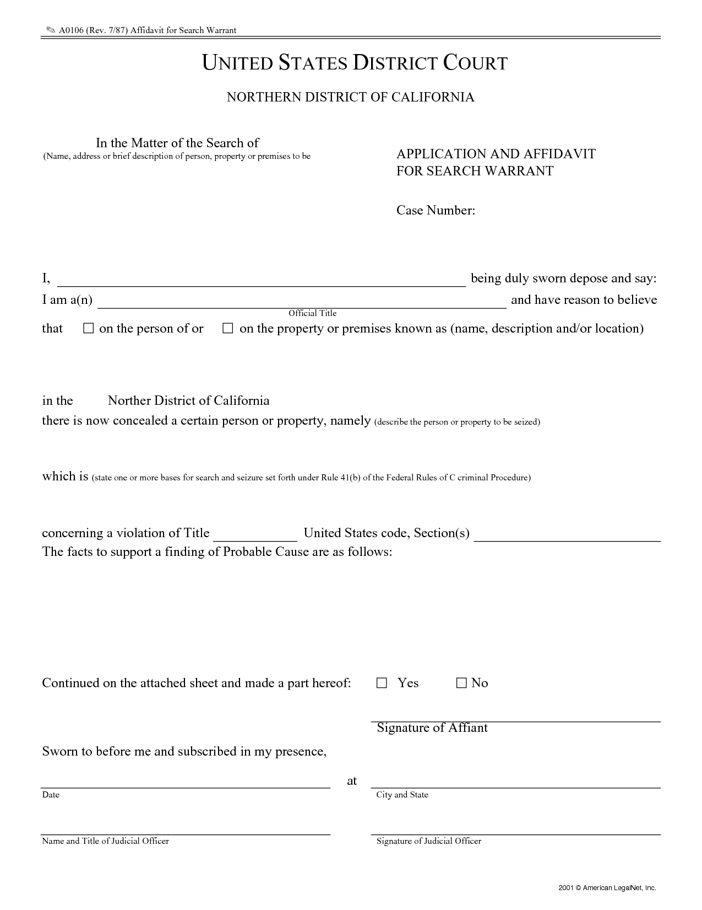
Lo que se busca (person o propiedad)
Lo Que se Busca
En donde se puede buscar (la dirección)
Firmado por un juez
FIRMA DEL JUEZ
Donde se Busca (Su dirrecion)

Slide 37
The object of the search (person or property)
Lo Que se Busca
What can be searched (the address)
Firmado por un juez
JUDGE’S SIGNATURE
Donde se Busca (Su dirrecion)

Slide 38
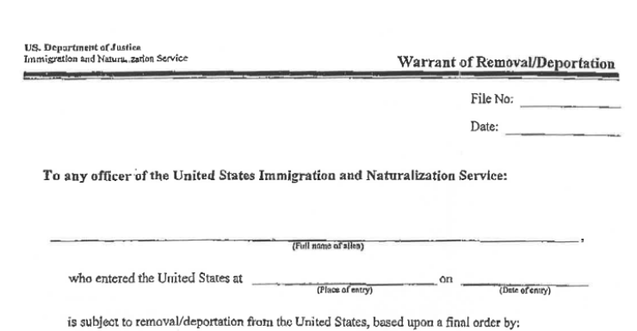
COMPARE WITH ICE ARREST WARRANT

Slide 39
COMPARADO CON ORDEN DE ARRESTO DE ICE

Slide 40
SEARCH WARRANT V. ICE ARREST WARRANT
Notes:
SEARCH WARRANT- valid to gain entry into a home (if correct information and signed by a judge) ONLY for the purpose of finding what is mentioned in the order (usually a person’s name, could also mention documents or materials)
ICE ARREST WARRANT- NOT valid to gain entry into a home, can be used in public to detain the person named in the warrant

Slide 41
ARRESTOS EN PUBLICO POR ICE
En público, una orden de arresto de ICE es suficiente para detener a alguien
¿Qué pasa si ICE detiene a alguien sin una orden de arresto?
ICE necesita una “razón para creer” que la persona está en el país sin permiso, y tiene que tener esta razón antes de detener la persona
Si ICE intenta detenerle en público:
Debe preguntar “¿Soy libre de irme?” Si dicen que sí, debe alejarse del lugar
Si ICE dice que no, utilice su derecho a guardar silencio y no conteste preguntas acerca de su nombre, historia criminal, estatus migratorio, o lugar de nacimiento
No debe mentir porque podría dañar su caso
¿Qué debo hacer si presencio una redada en público?
No corre, pero si está a riego de una parada por inmigración y no está detenida, debe intentar alejarse del lugar
Si está seguro, considera recordando los detalles de la parada, con video, fotos, o apuntes escritos
Notes:
It’s important to not interfere with law enforcement action, but details of rights violations may be helpful to the detained person later on. Badge numbers and officer names are particularly helpful if available.

Slide 42
ICE ARRESTS IN PUBLIC
In public, an ICE arrest warrant suffices to detain someone
What about ICE stops in public, without a warrant?
ICE needs “reason to believe” that someone is in the country without permission, and must have this reason before detaining someone
If ICE tries to detain you in public:
Ask “Am I free to go?” If ICE says yes, walk away
If ICE says no, exercise your right to remain silent and do not answer questions about your name, criminal, and immigration history
Do not lie, as it can hurt your case later on
What if I witness a raid in public?
Do not run, but if you believe you may be at risk of immigration enforcement action and are not detained, try to leave the area
If you are safe, consider recording details of the stop either with video, photo, or notetaking
Notes:
It’s important to not interfere with law enforcement action, but details of rights violations may be helpful to the detained person later on. Badge numbers and officer names are particularly helpful if available.

Slide 43
PLANES DE SEGURIDAD
Memorice números de teléfono que son importantes
Su esposo o pareja, hijos, amigo de confianza, y abogado
Personas detenidas no tienen acceso a sus celulares
Organice documentos importantes en un lugar seguro
Haz copies y asegure que alguien de confianza sabe en donde esta
Si tiene numero de A, asegure que su familia lo sepa
Haz un plan para el cuidado y custodia temporal de sus hijos
Piensa en escoger un adulto de confianza que puede cuidar temporalmente por sus niños si usted es detenido
Prepare una Autorización de Cuidador
Pide pasaportes para sus niños
Dígalo a ICE si usted es la única persona cuidado por sus niños
Notes:
Because of the uncertain future, it’s not a bad idea to make a safety plan in case you or a loved one is placed in removal proceedings.
Caregiver’s authorization- does not affect your rights as a parent, but allows a non-parent relative enroll child in school and make school-related decisions on your child’s behalf in your absence.
LAUSD form- available online and also through school office.
ICE has the discretion to not detain primary caregivers of minor children (though they can detain you and likely will if you have criminal history)

Slide 44
SAFETY PLANS
Memorize important phone numbers
Your spouse or partner, children, trusted friend, and lawyer
If you are detained, you will lose access to your cell phone
Organize important documents in a safe place
Make copies and make them accessible to a trusted person
If you have an A number, make sure your family knows it
Make a plan for the temporary care and custody of children
Consider designating a trusted adult to temporarily care for your children in the case of your detention
Prepare a Caregiver’s Authorization
Request passports for your children
Tell ICE if you are the primary caregiver of children
Notes:
Because of the uncertain future, it’s not a bad idea to make a safety plan in case you or a loved one is placed in removal proceedings.
Caregiver’s authorization- does not affect your rights as a parent, but allows a non-parent relative enroll child in school and make school-related decisions on your child’s behalf in your absence.
LAUSD form- available online and also through school office.
ICE has the discretion to not detain primary caregivers of minor children (though they can detain you and likely will if you have criminal history)

Slide 45
PREGUNTAS? Questions?

